Slide 1
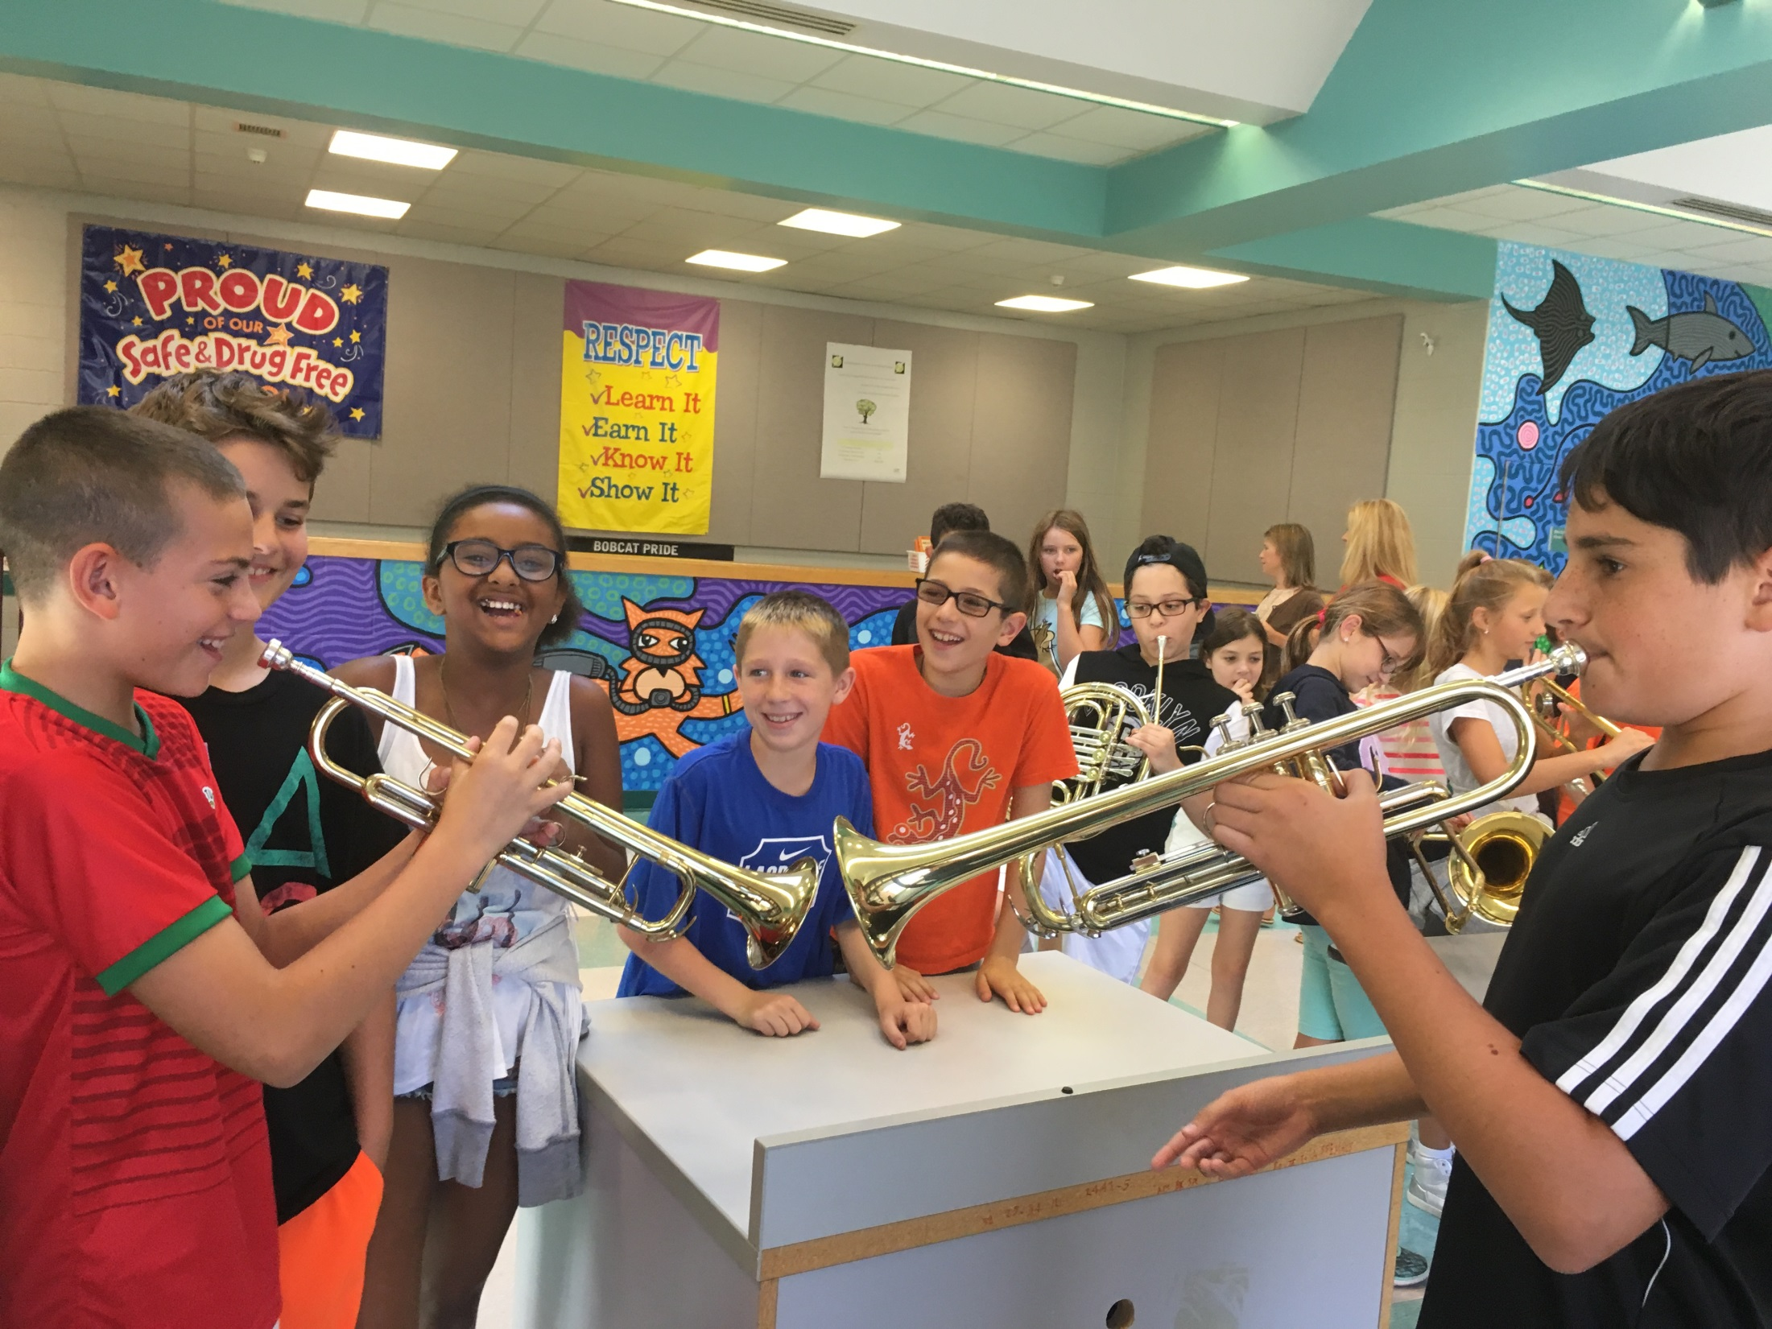
HBS Instrument Petting Zoo

Slide 2
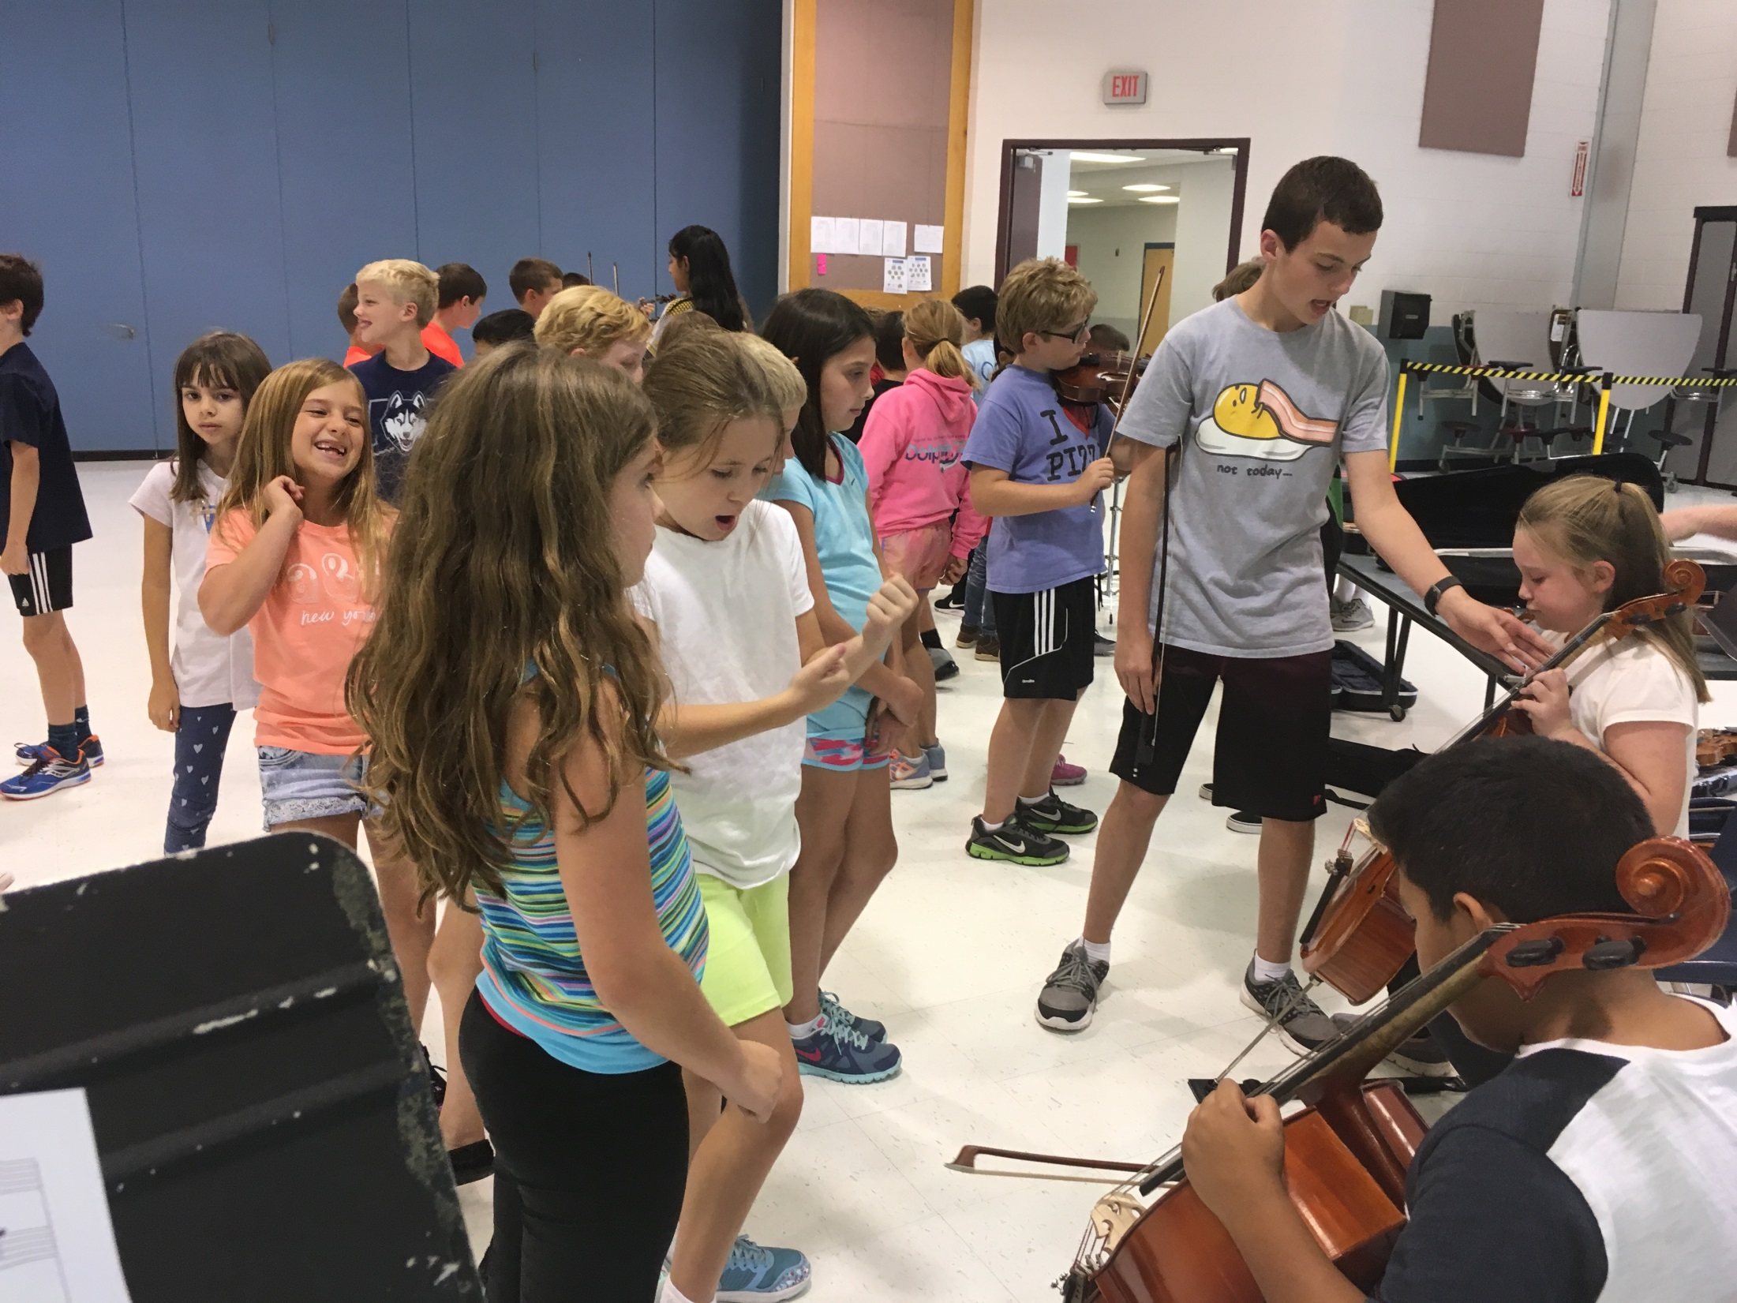

Slide 3
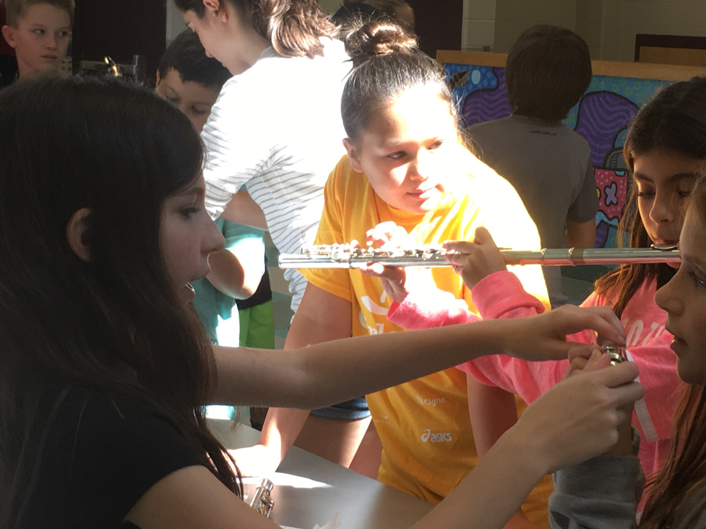

Slide 4
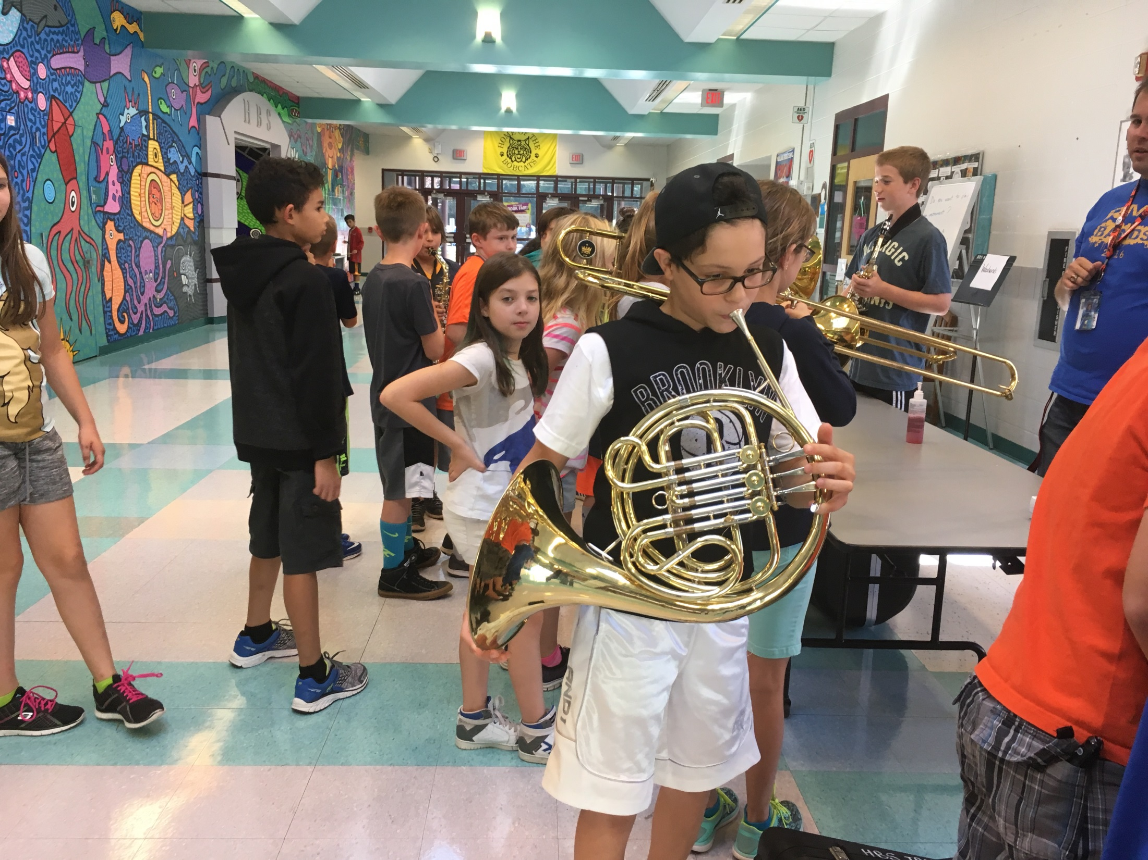

Slide 5
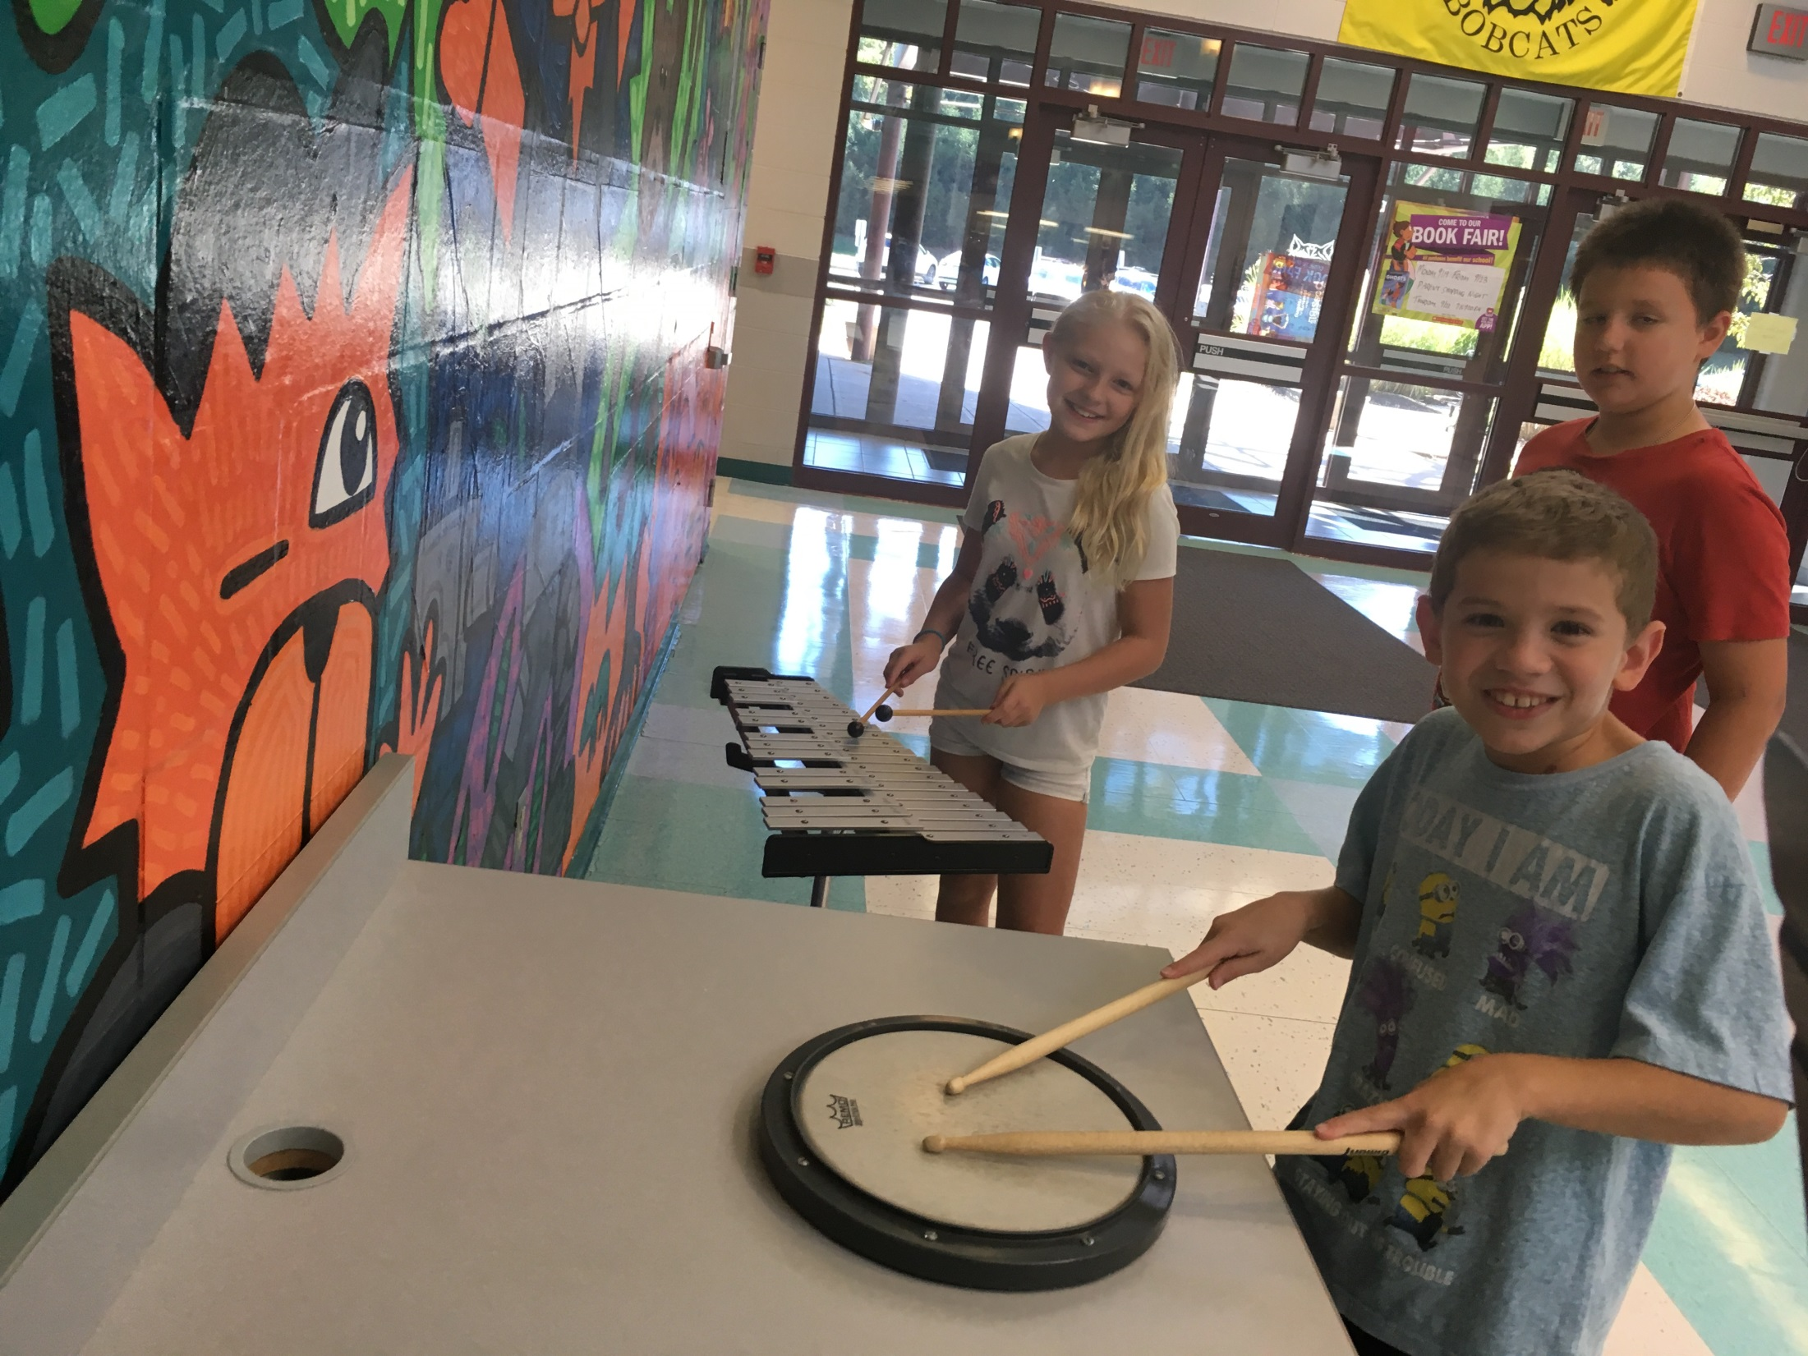

Slide 6
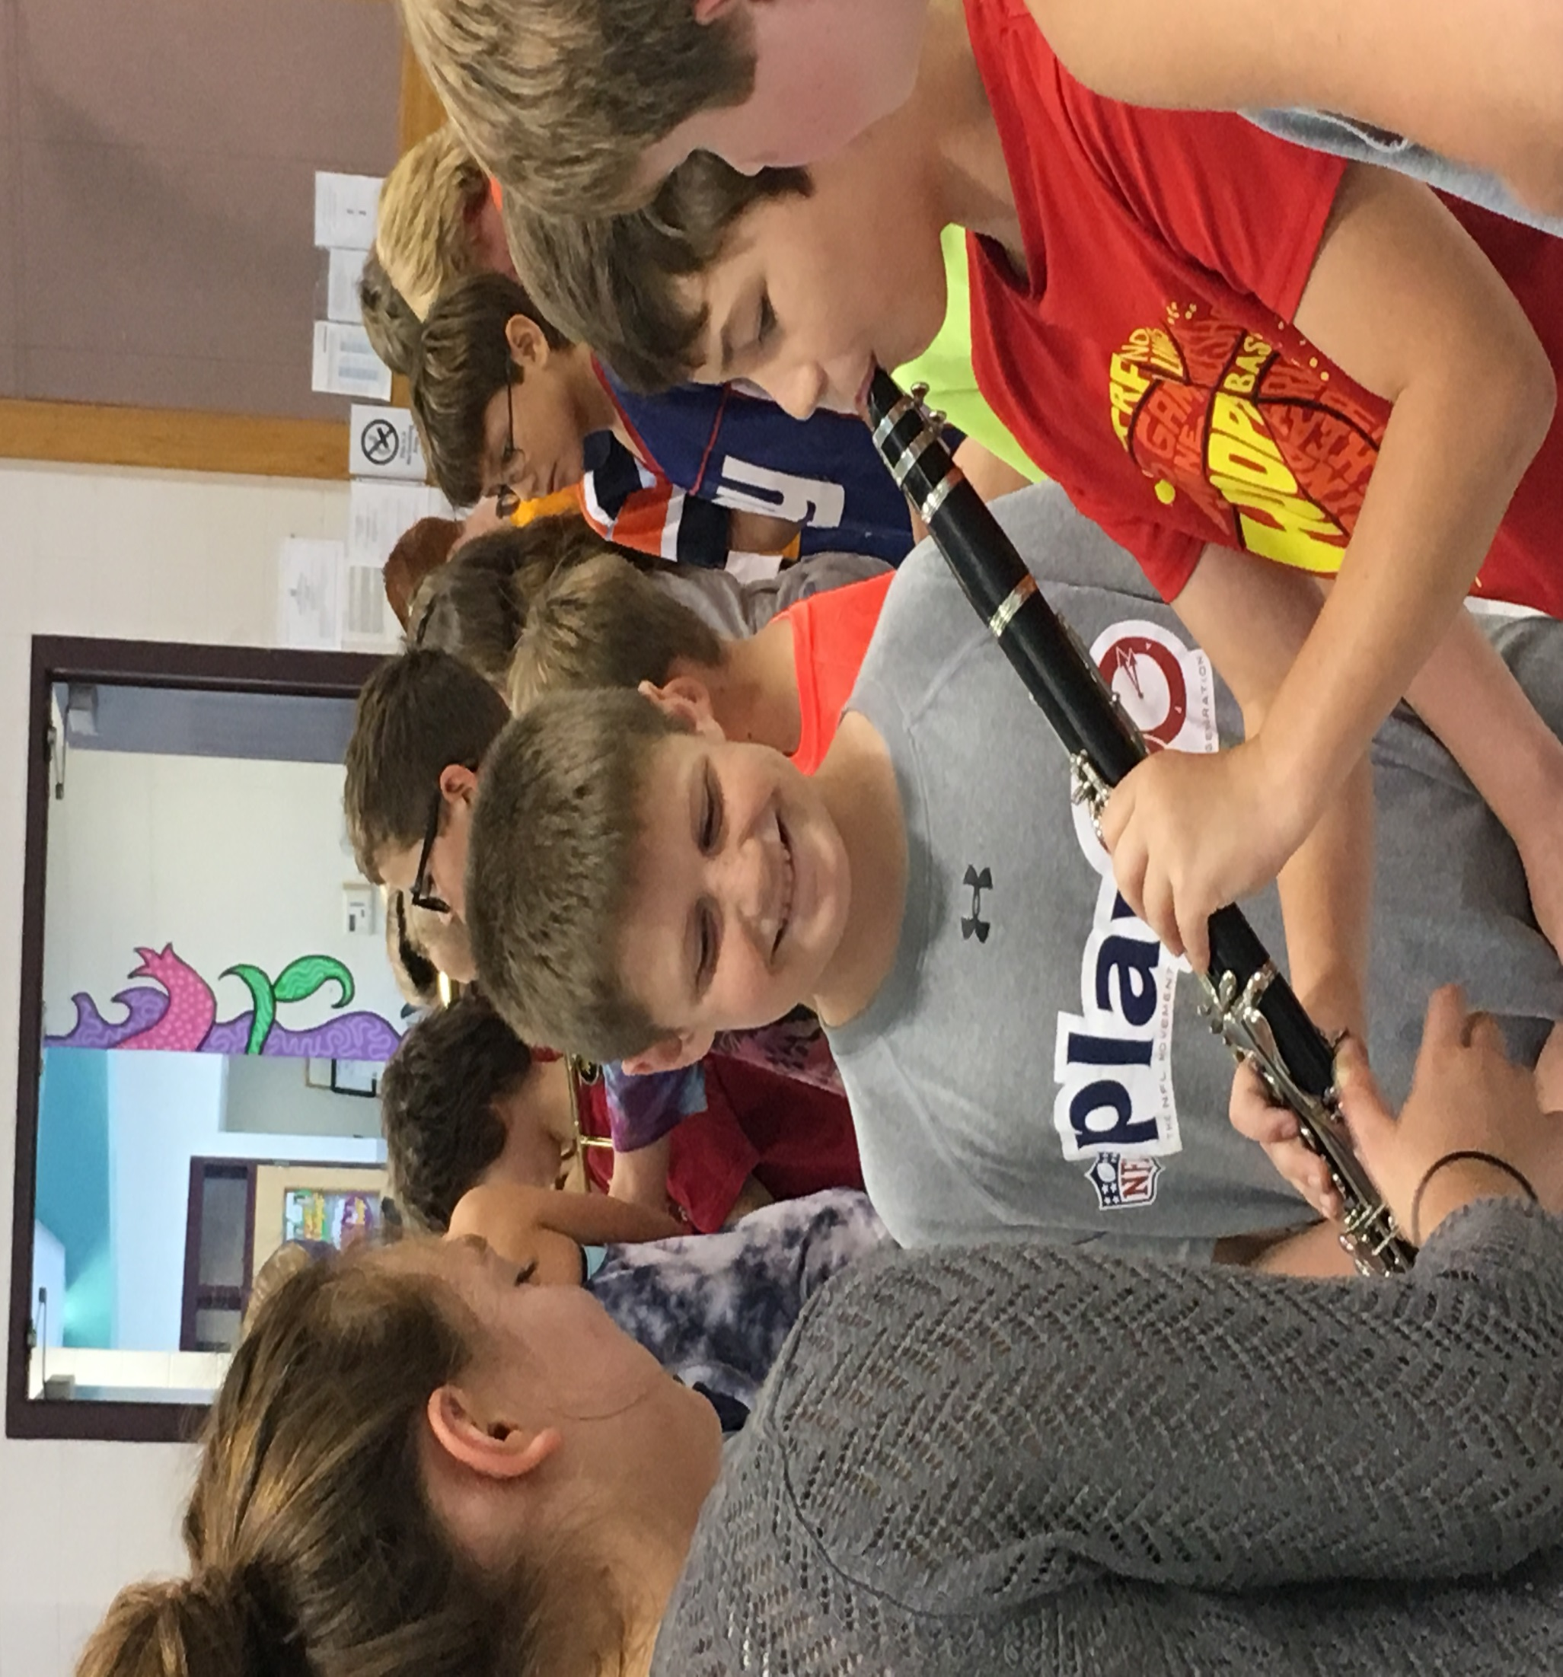

Slide 7
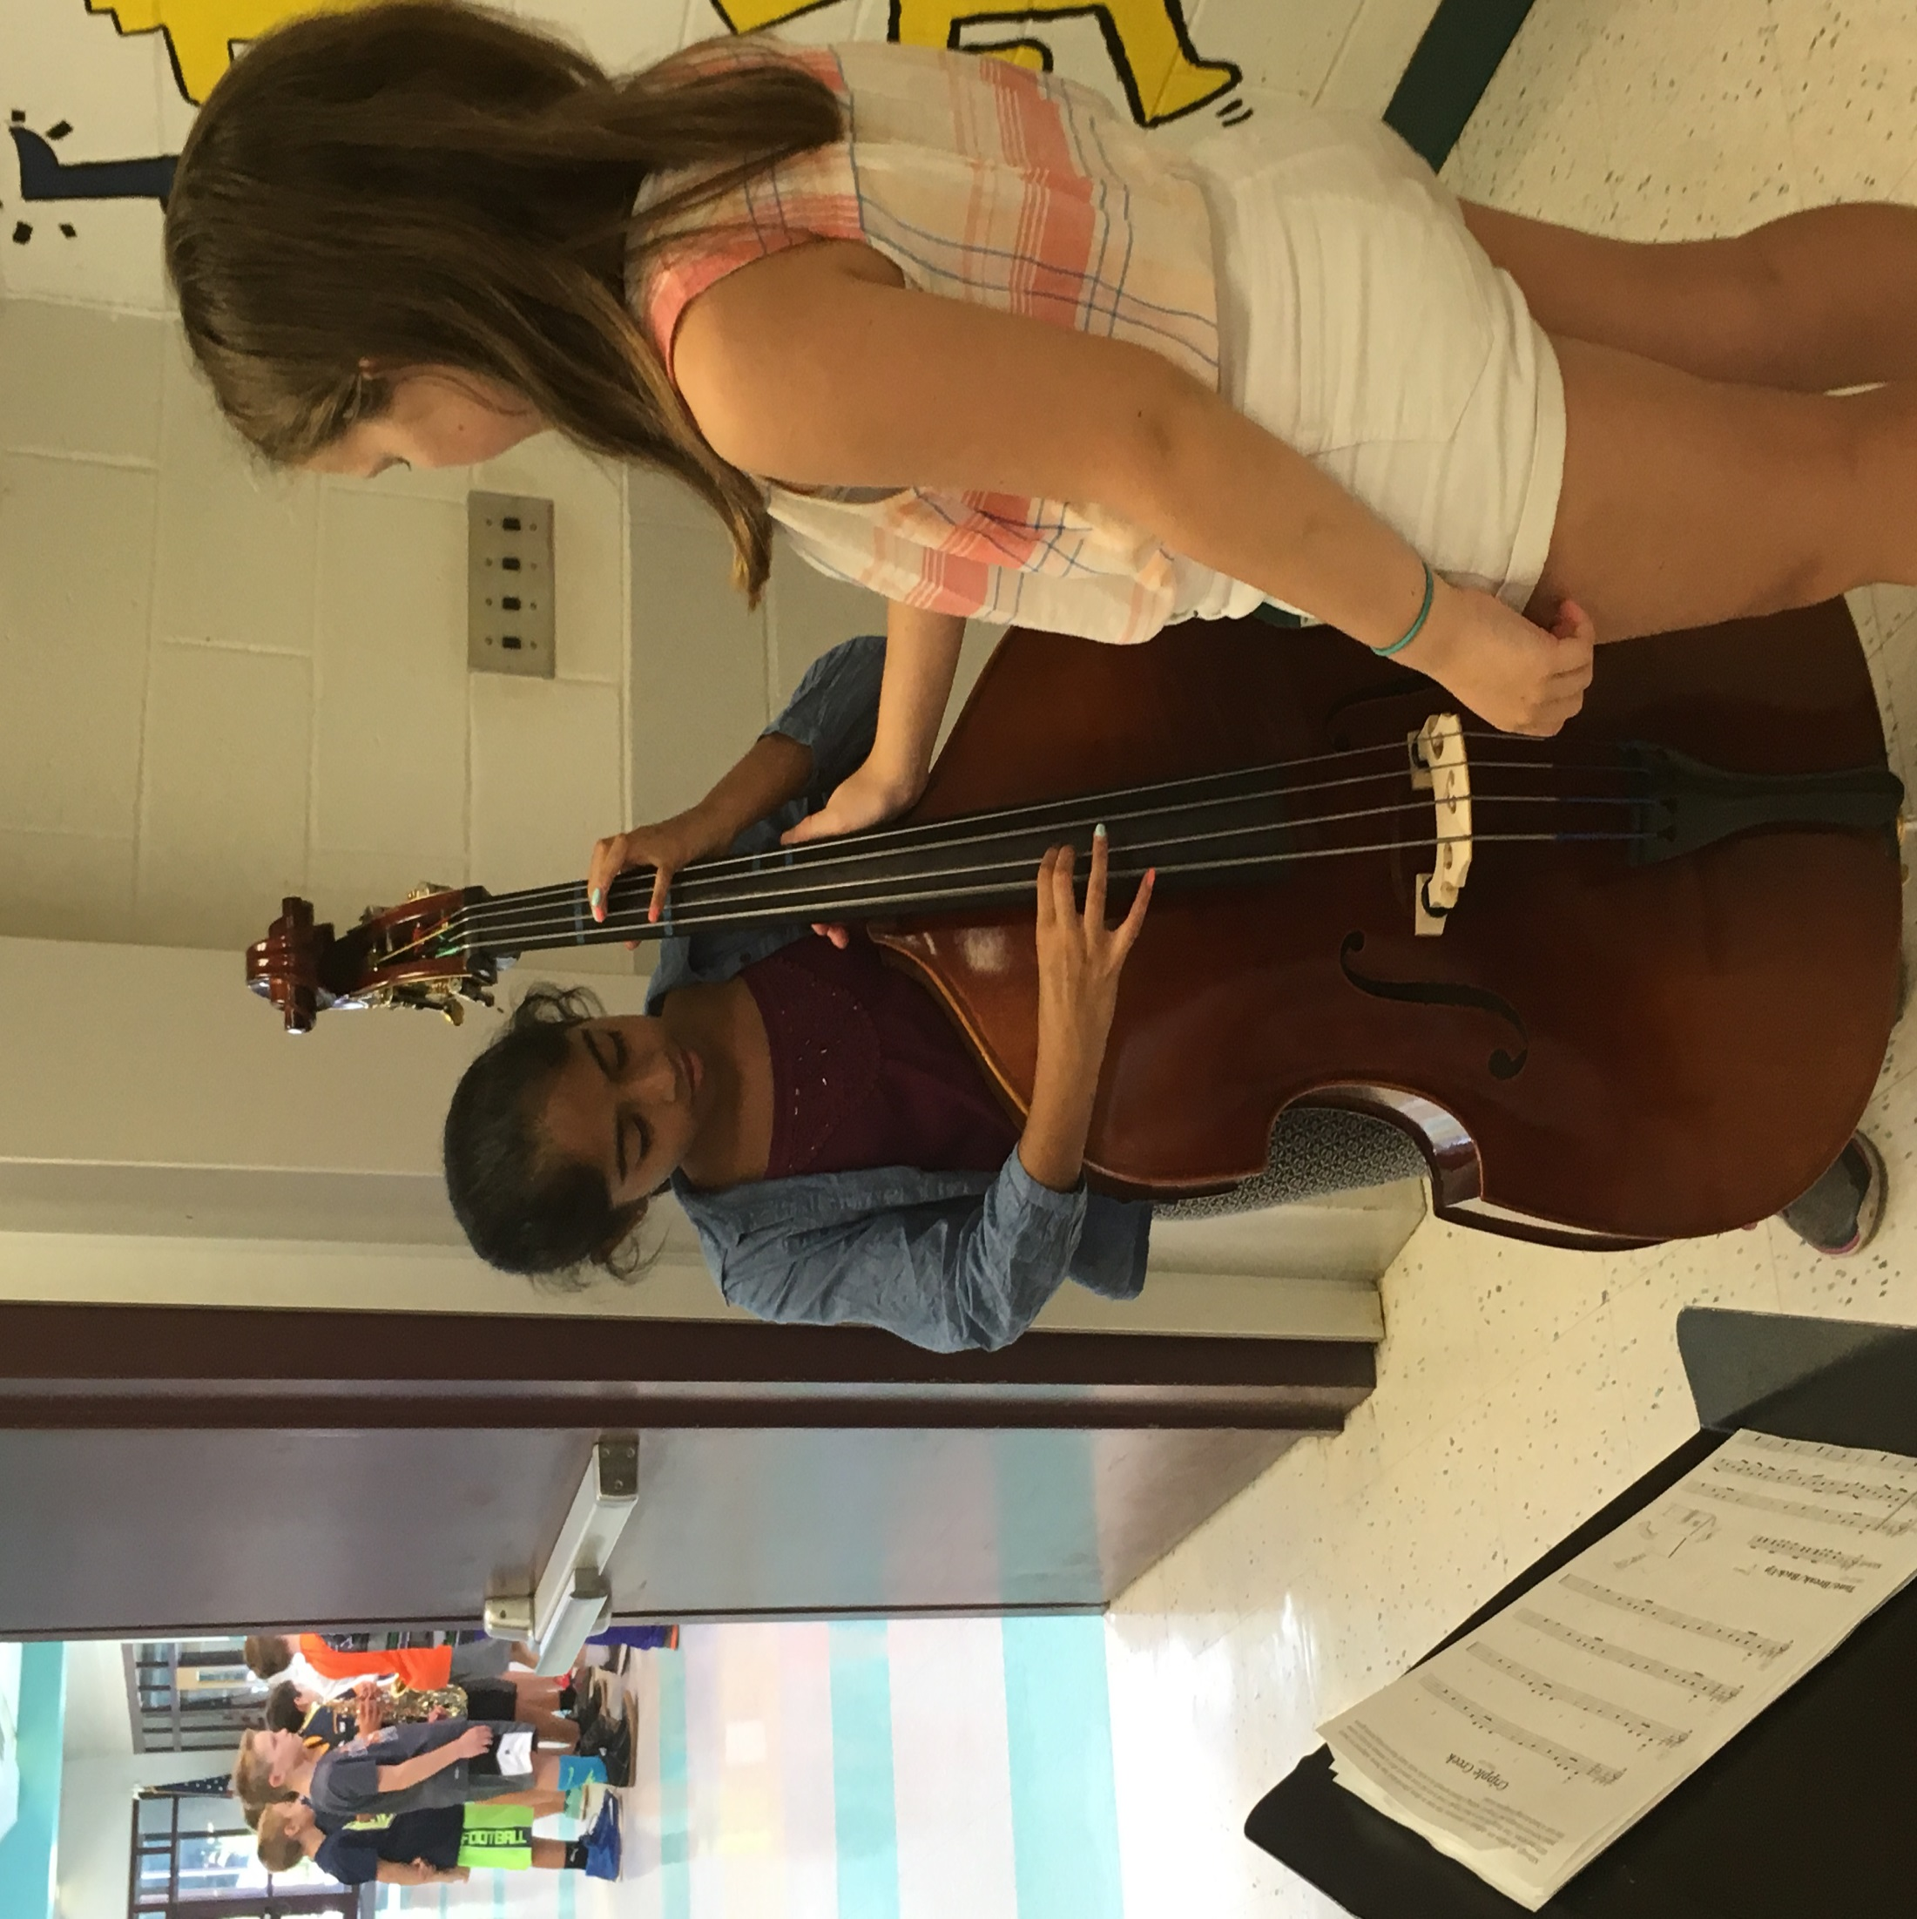

Slide 8
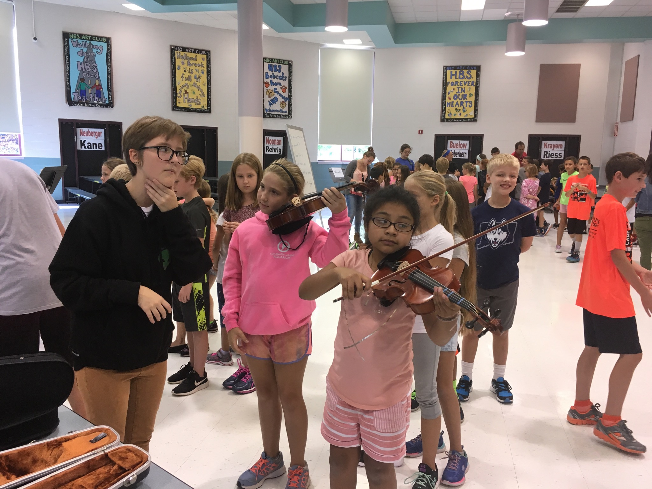

Slide 9
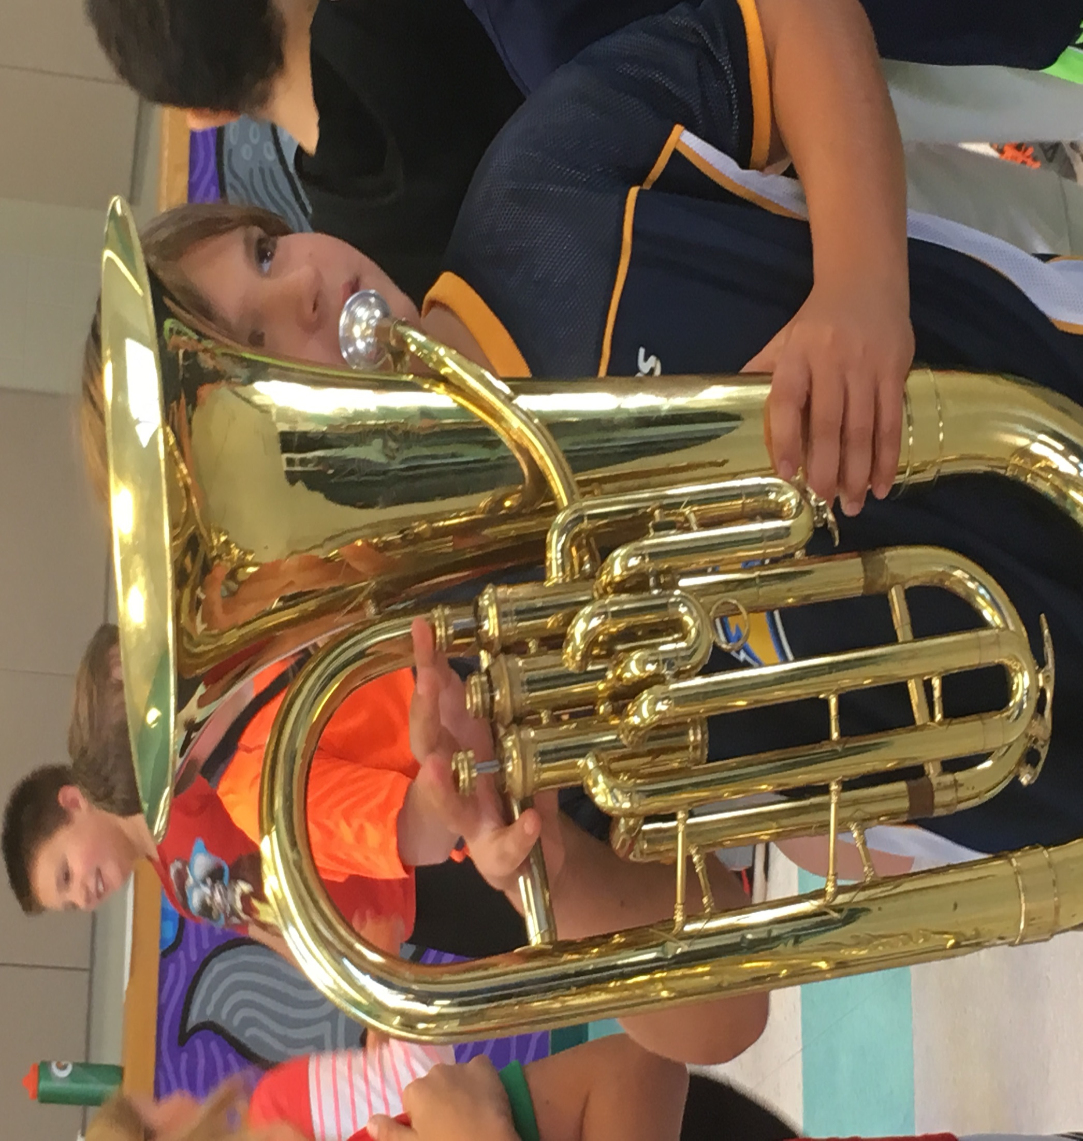

Slide 10
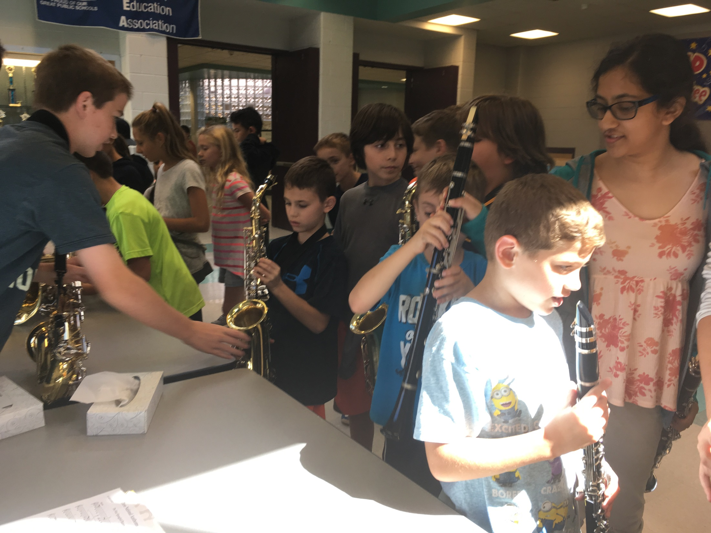

Slide 11
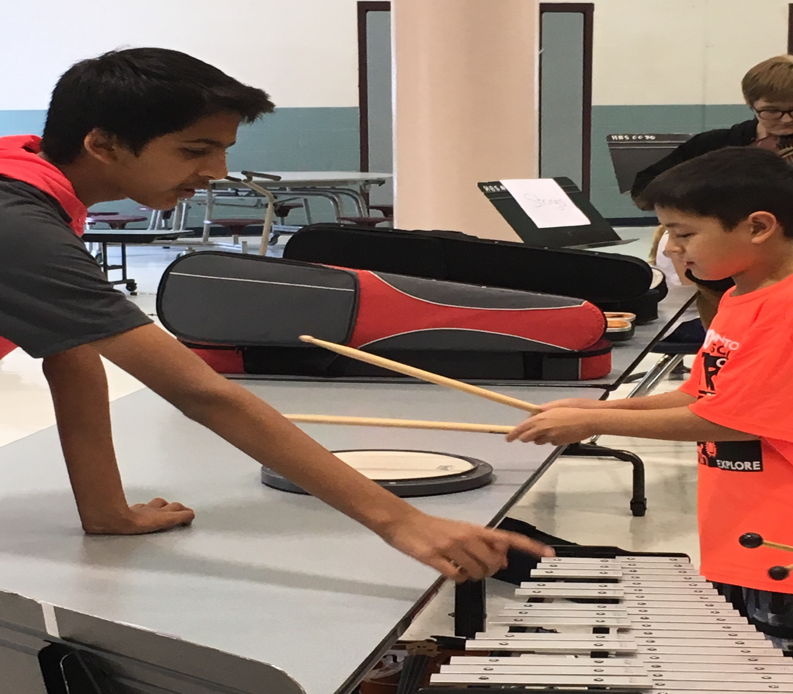

Slide 12
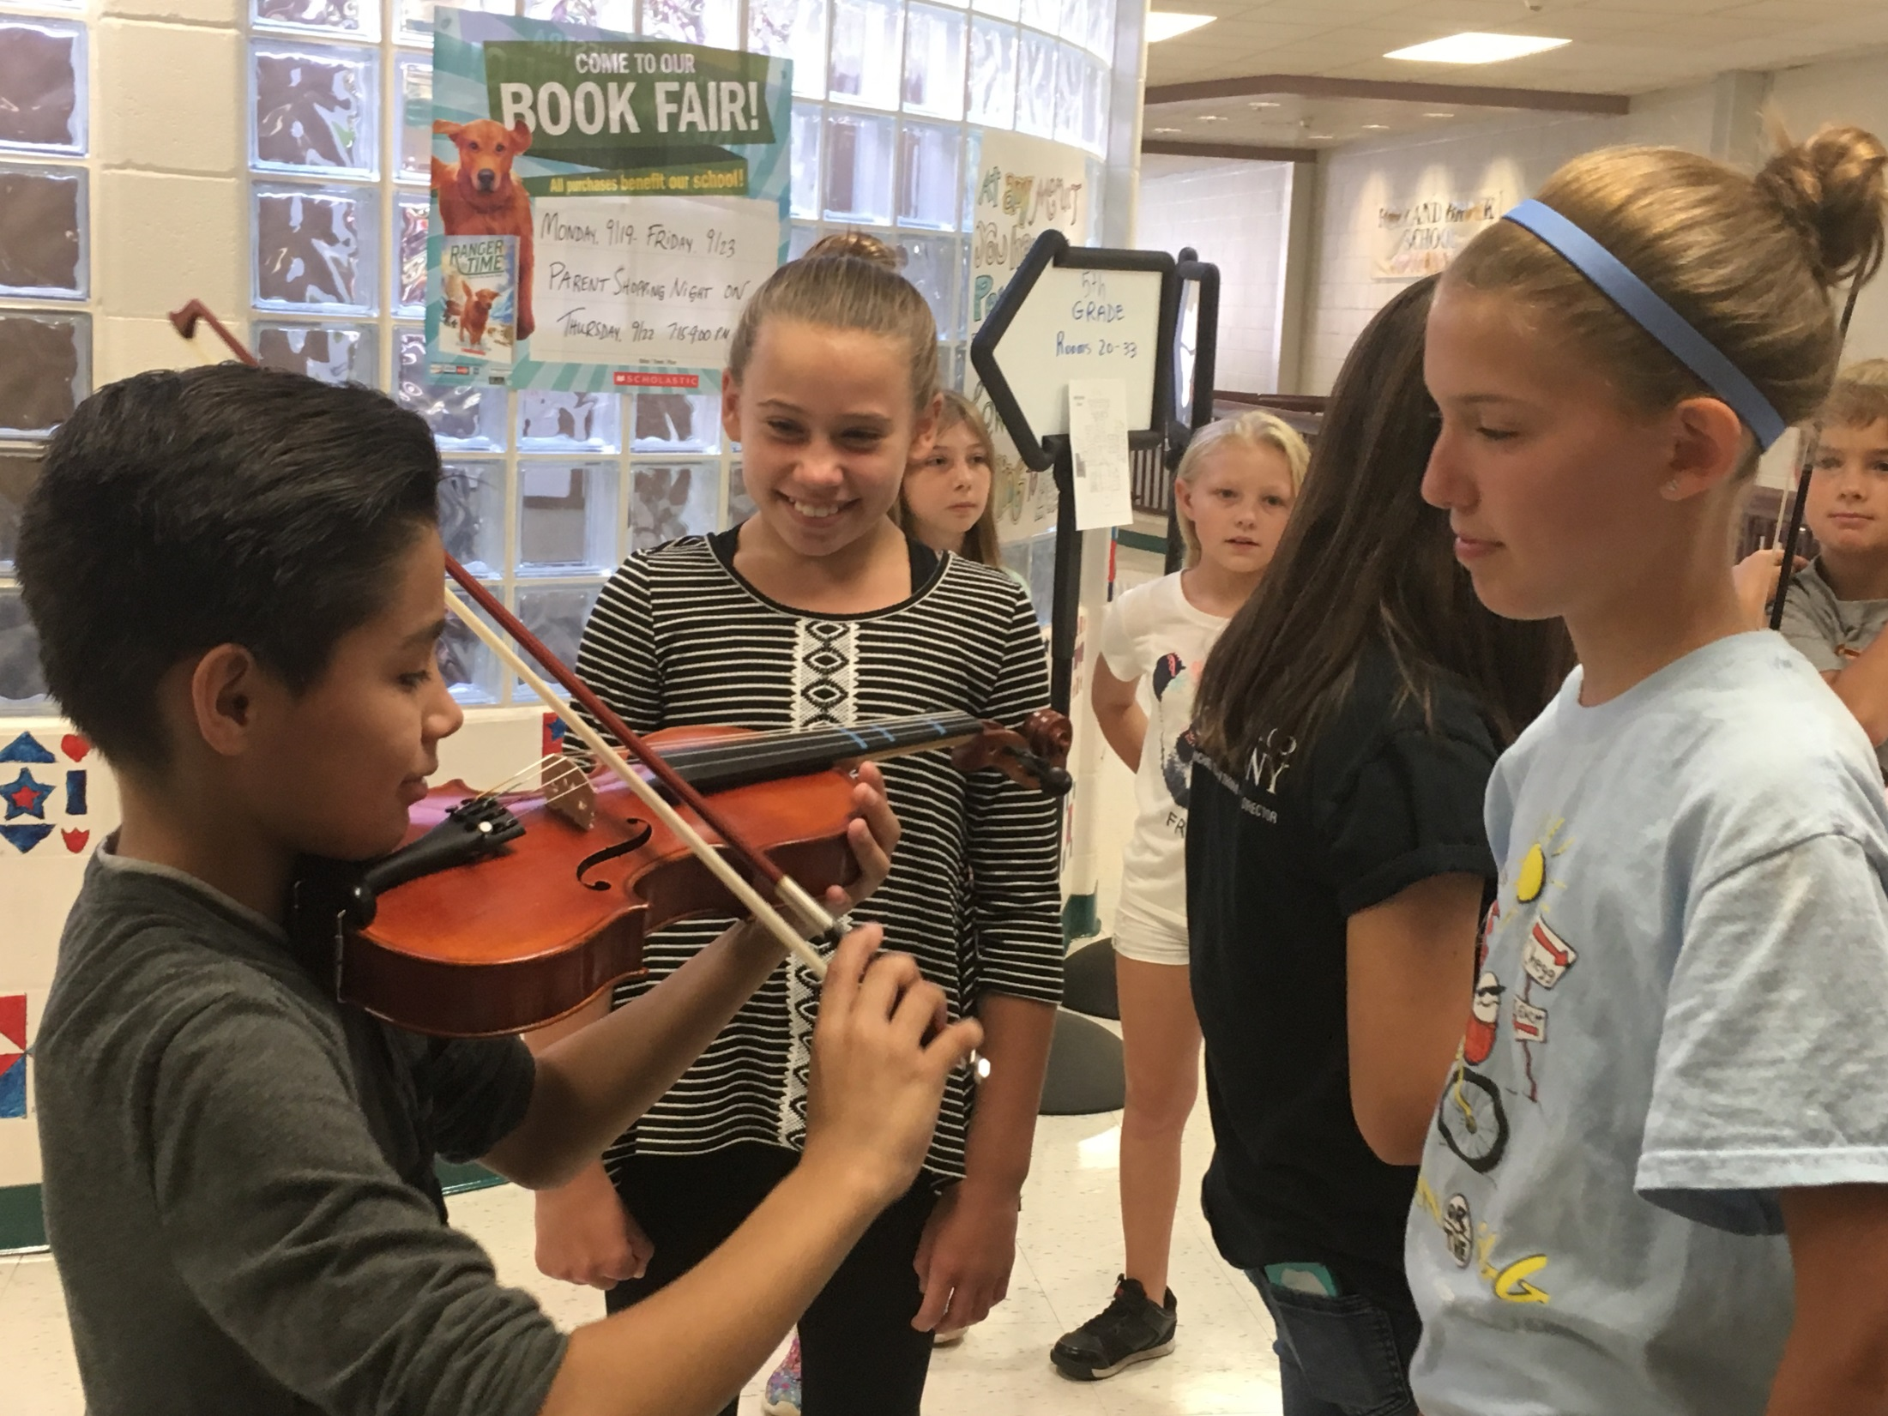

Slide 13
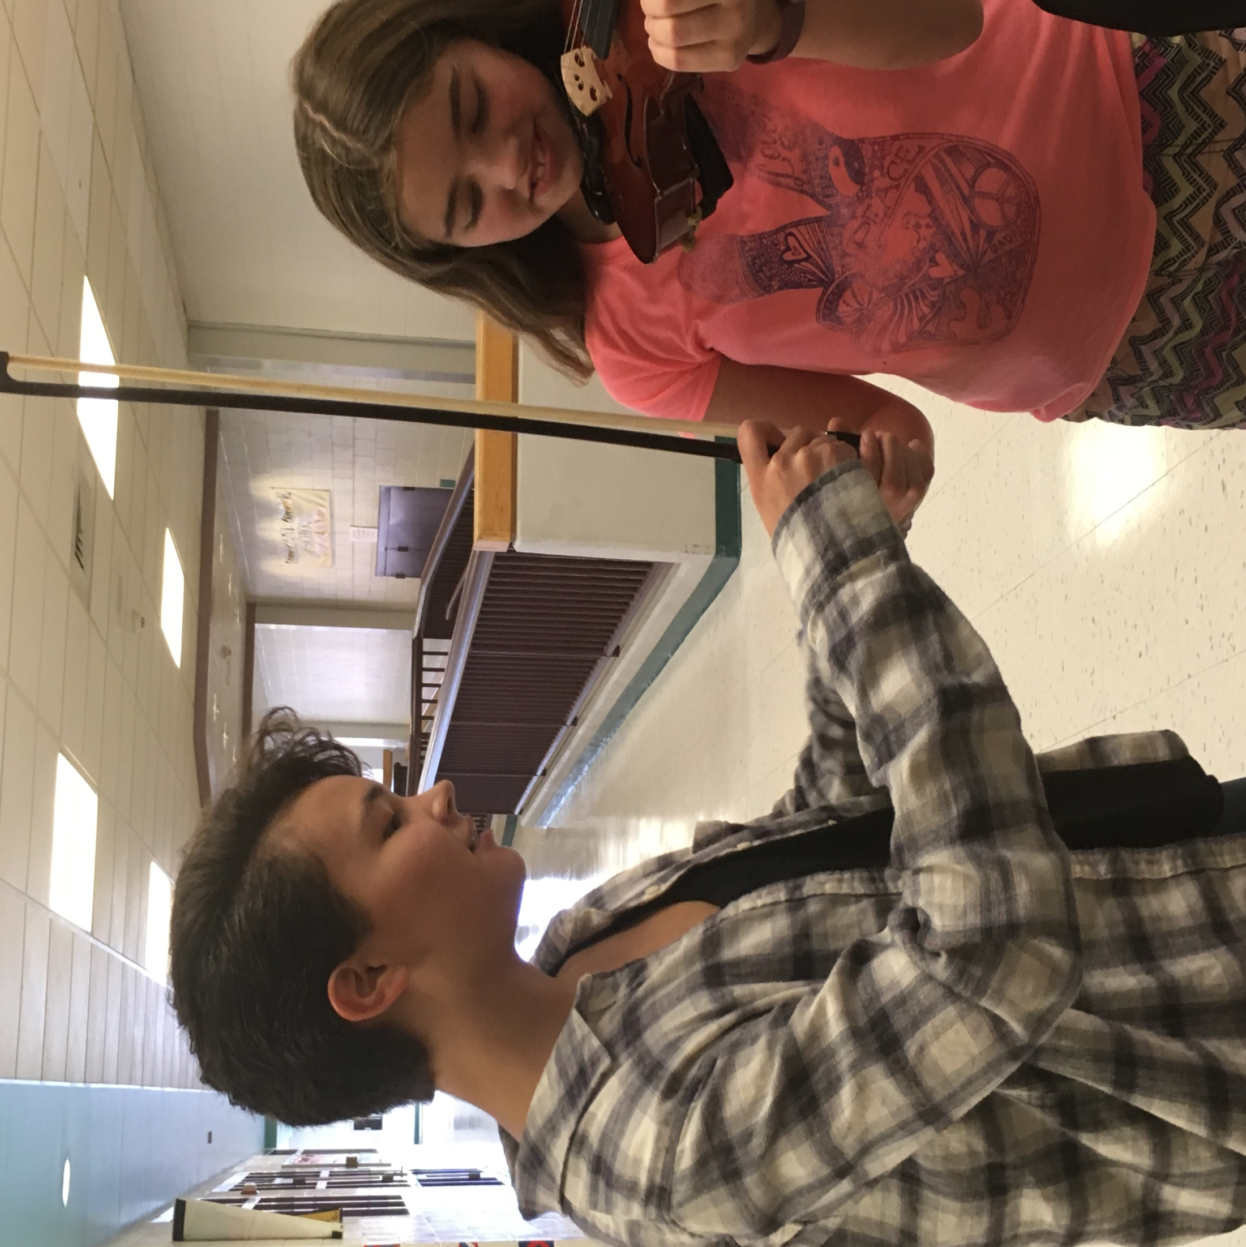

Slide 14
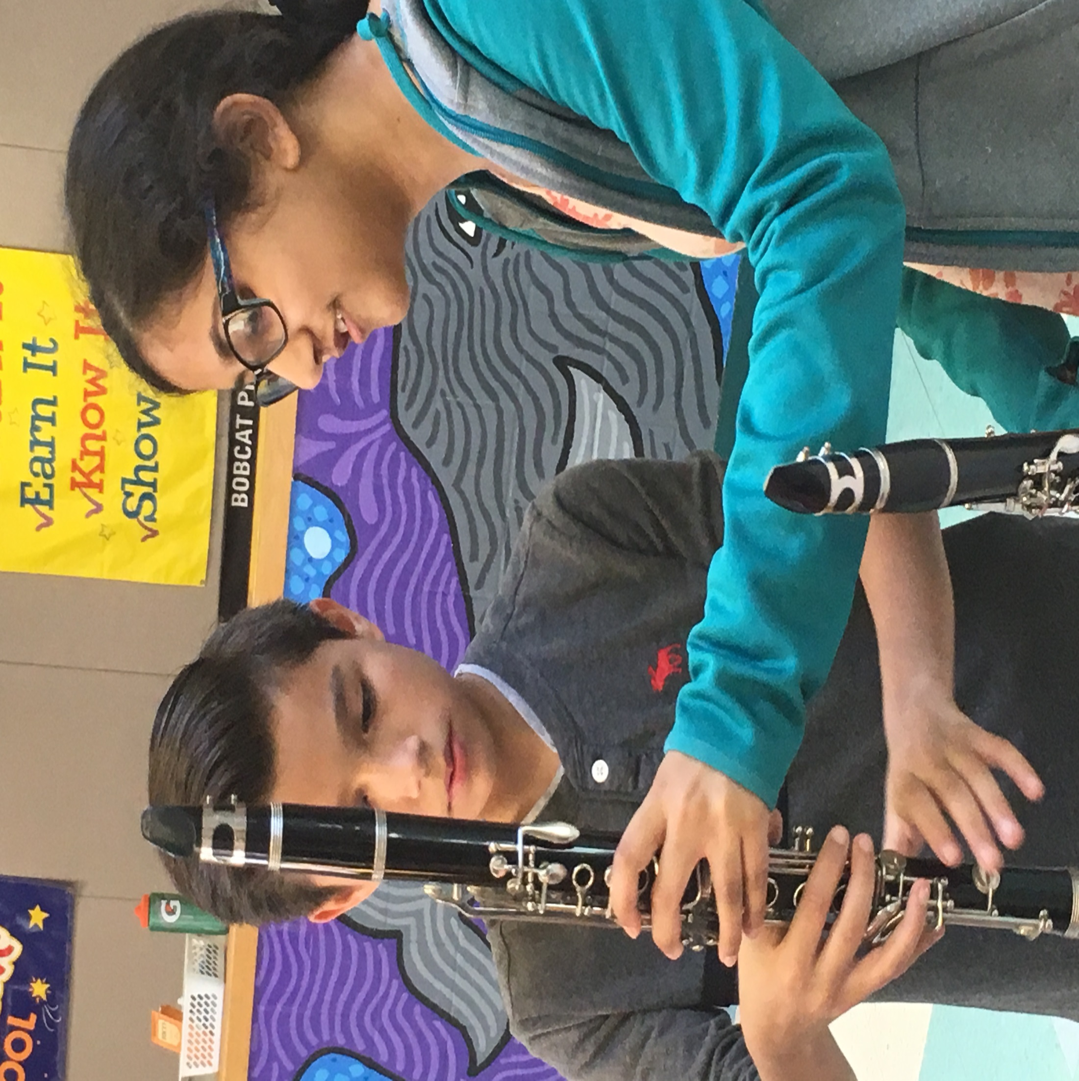

Slide 15
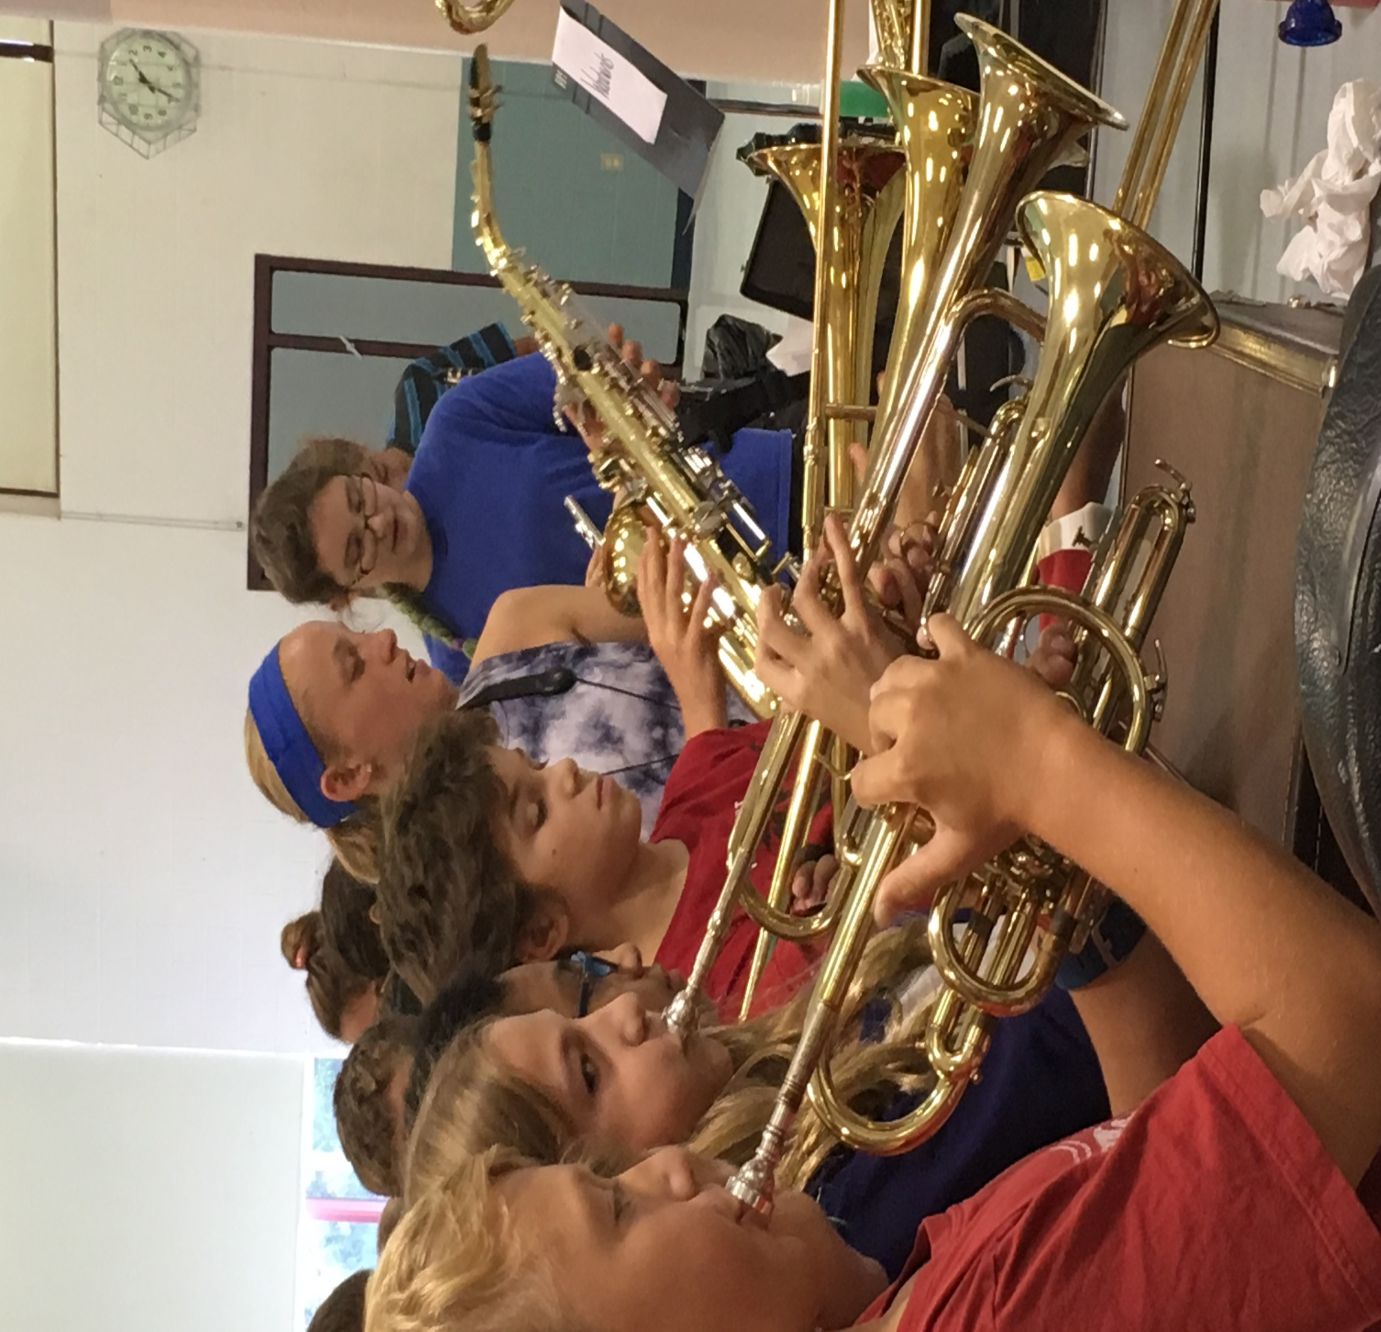

Slide 16
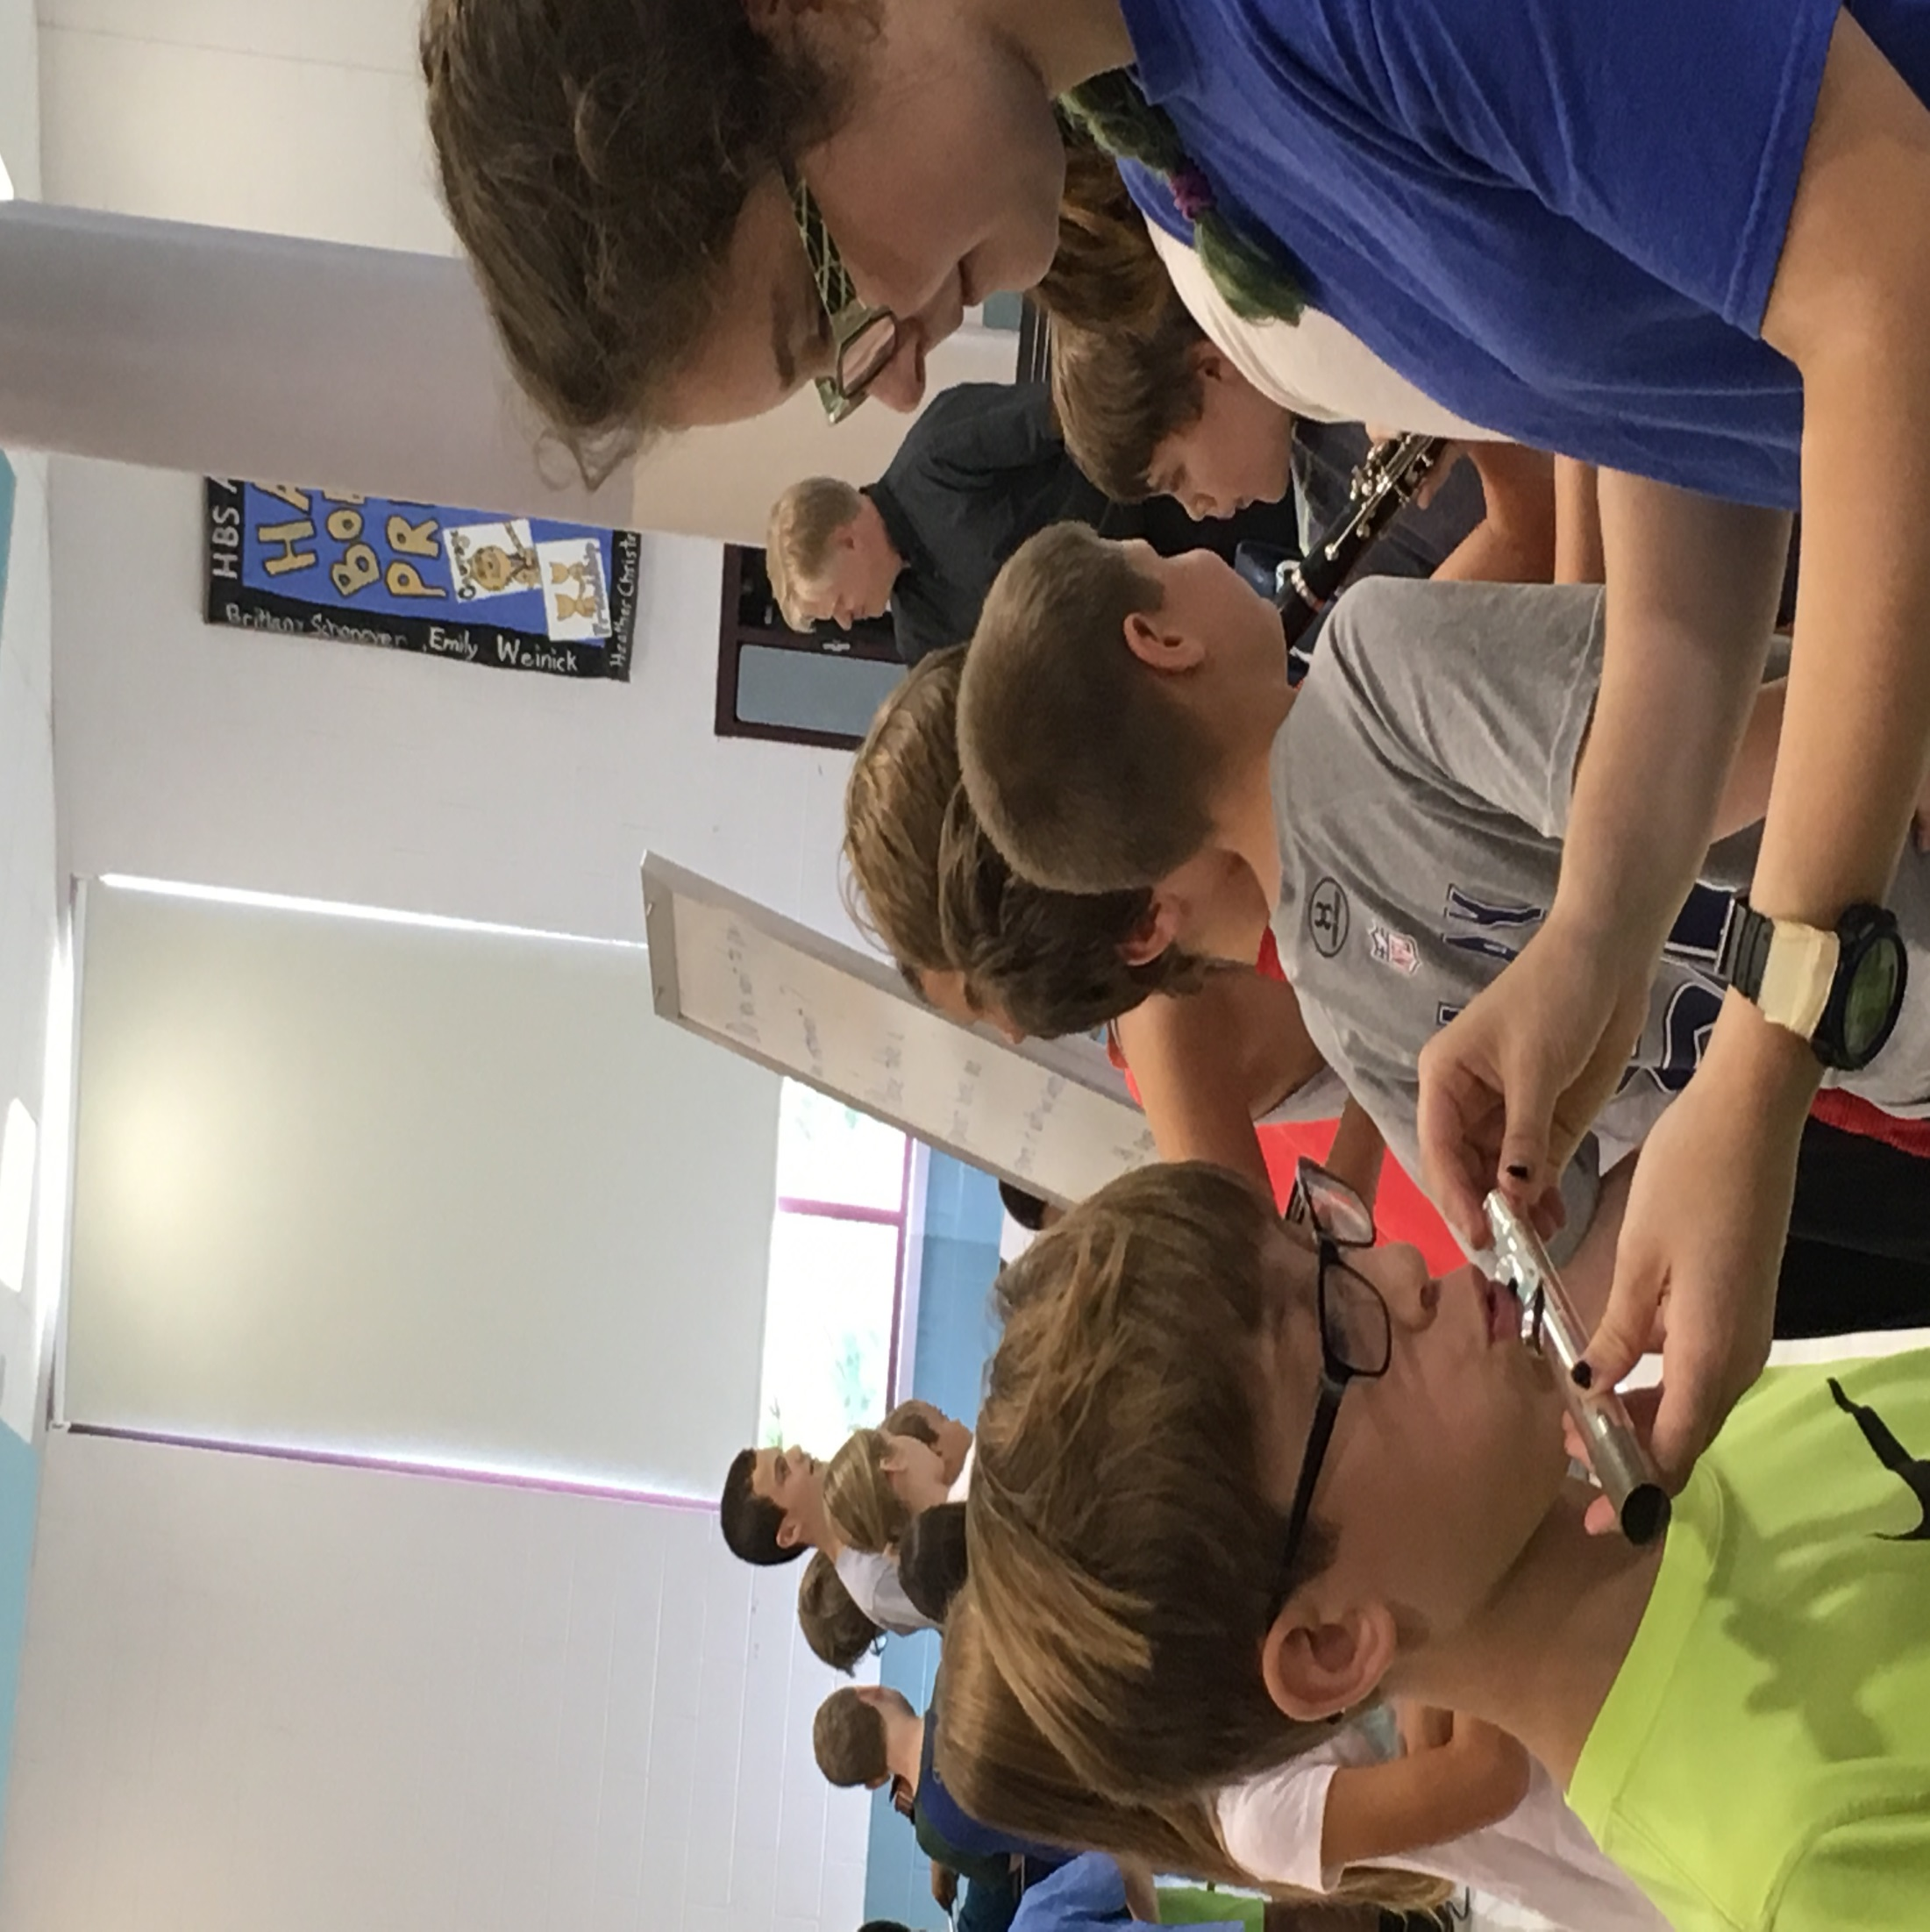

Slide 17
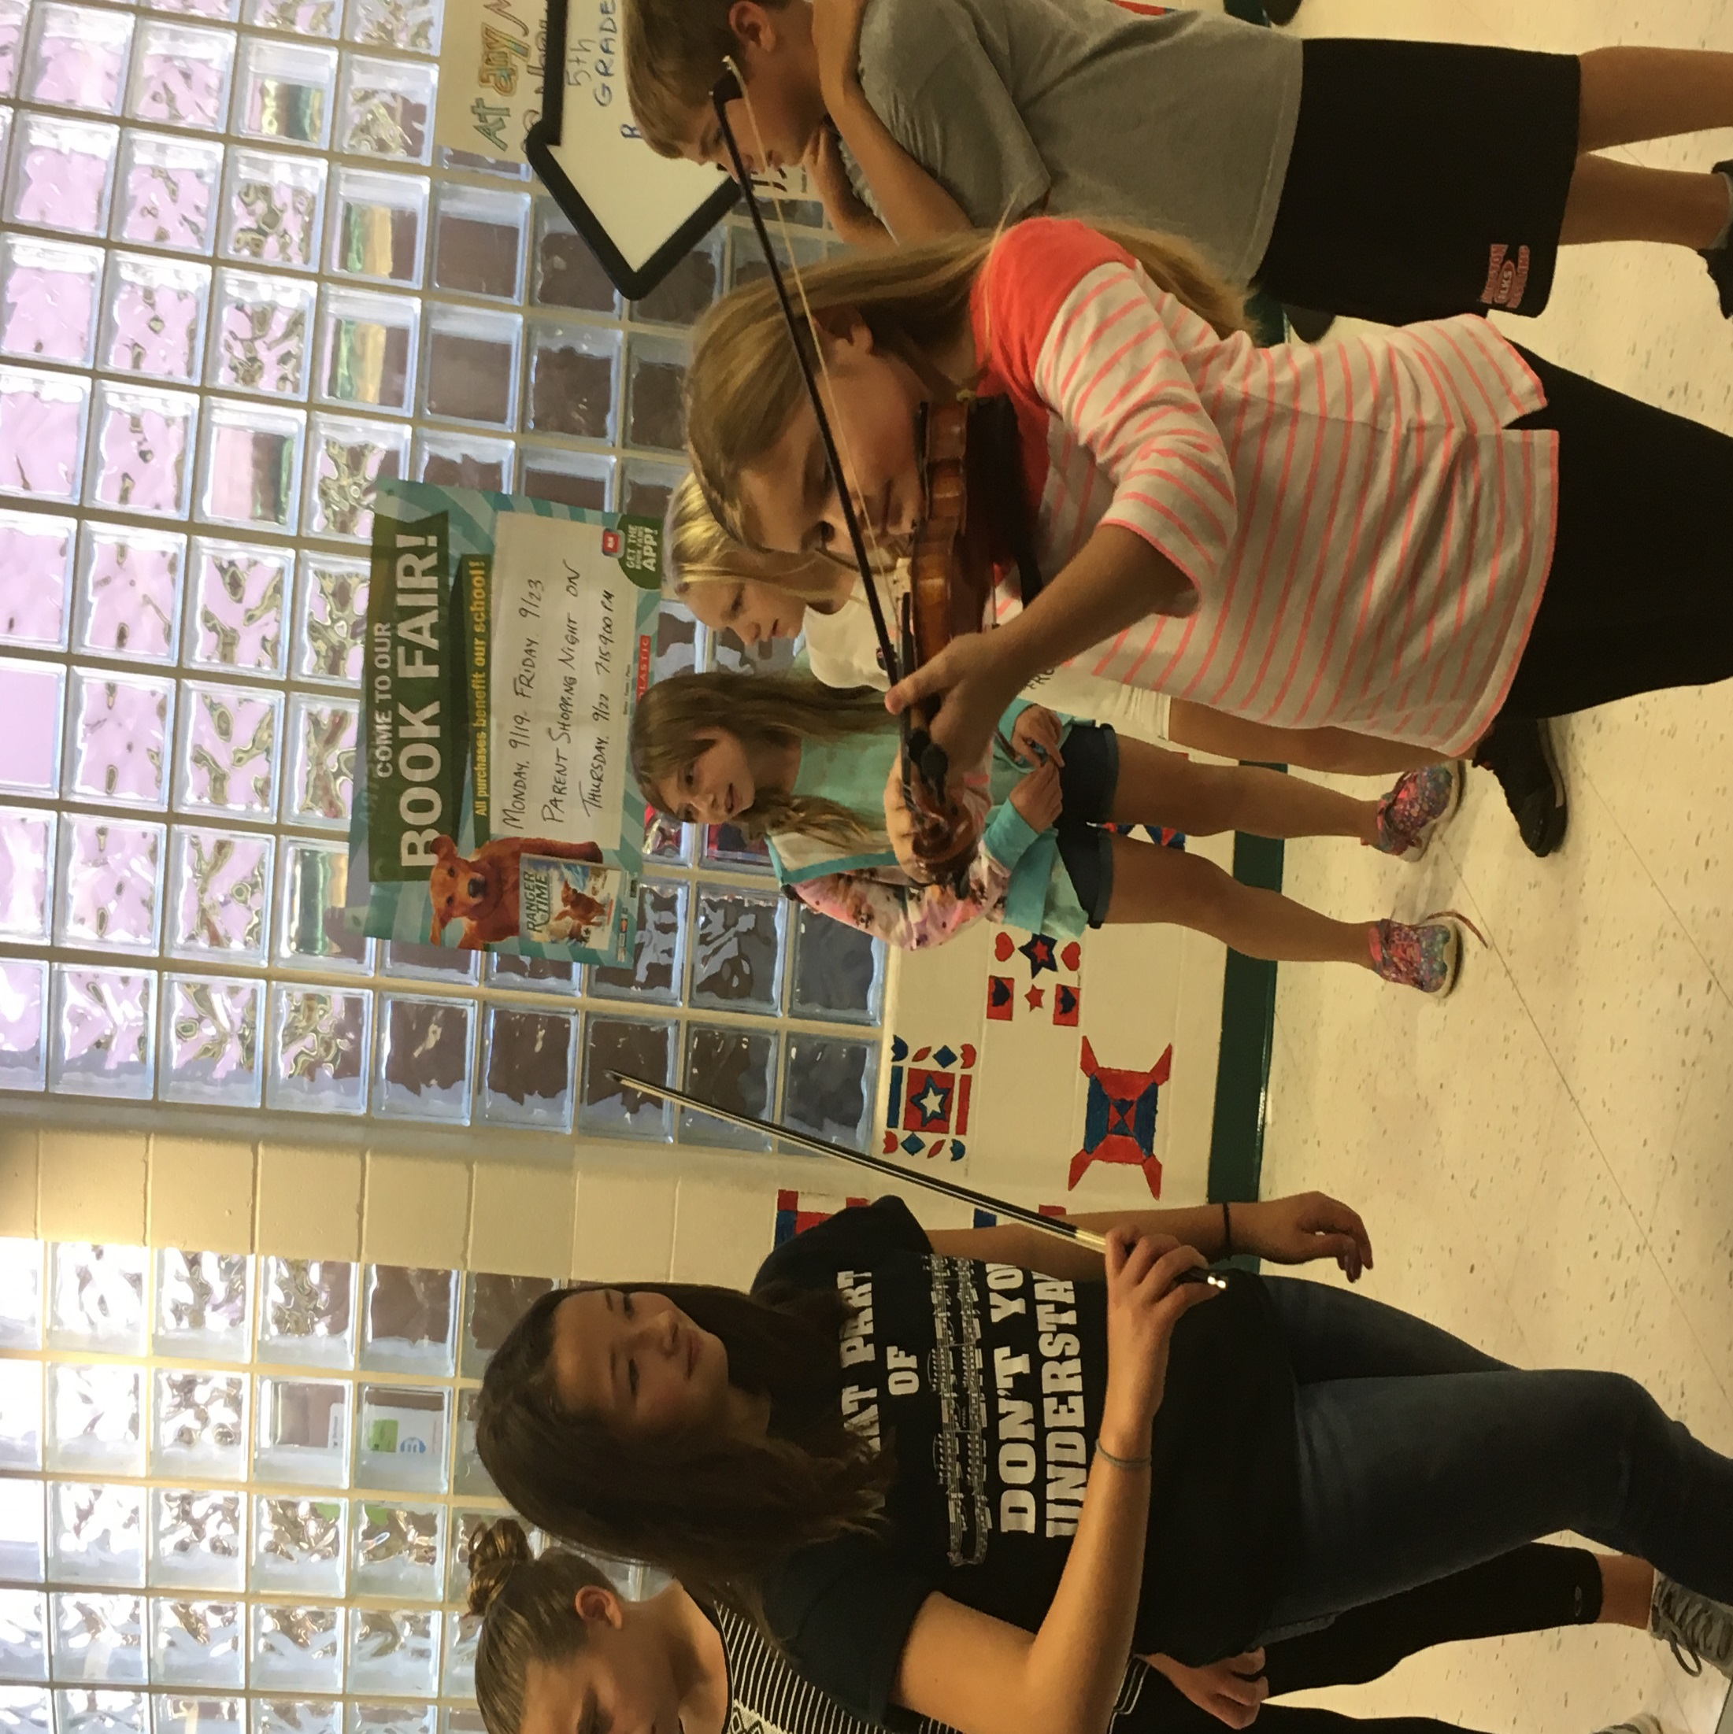

Slide 18
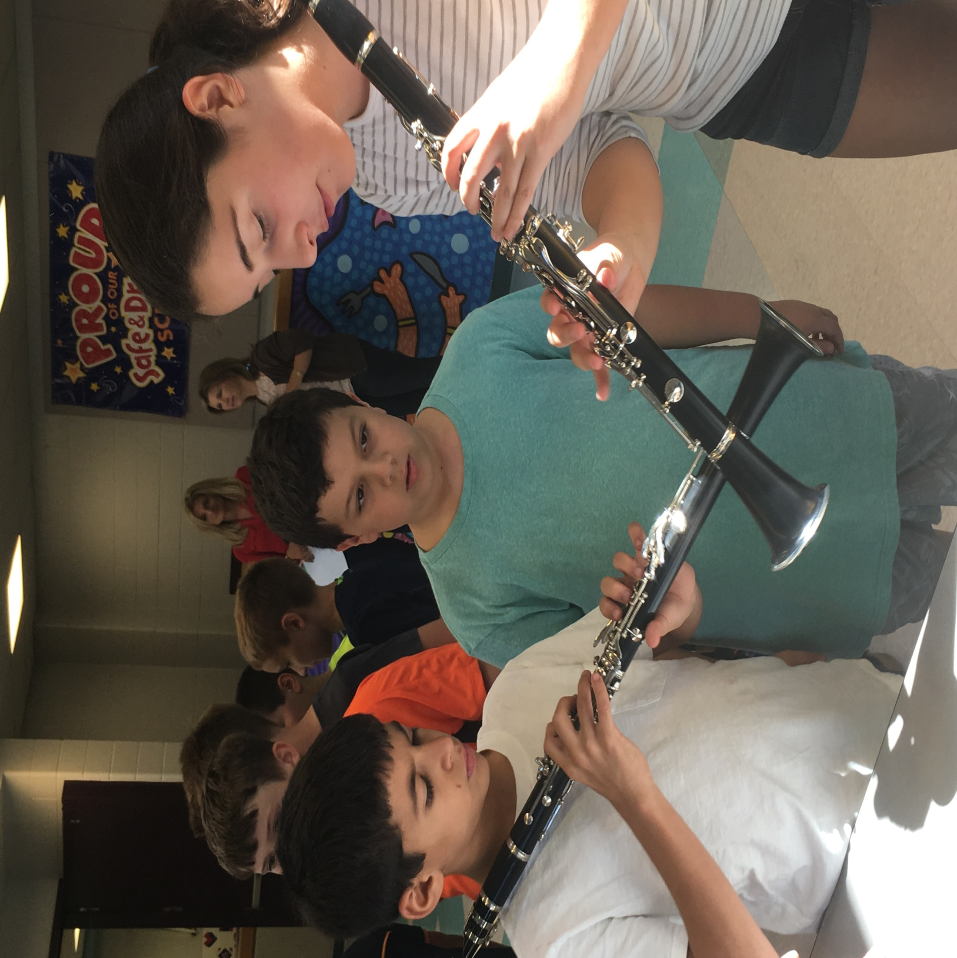

Slide 19
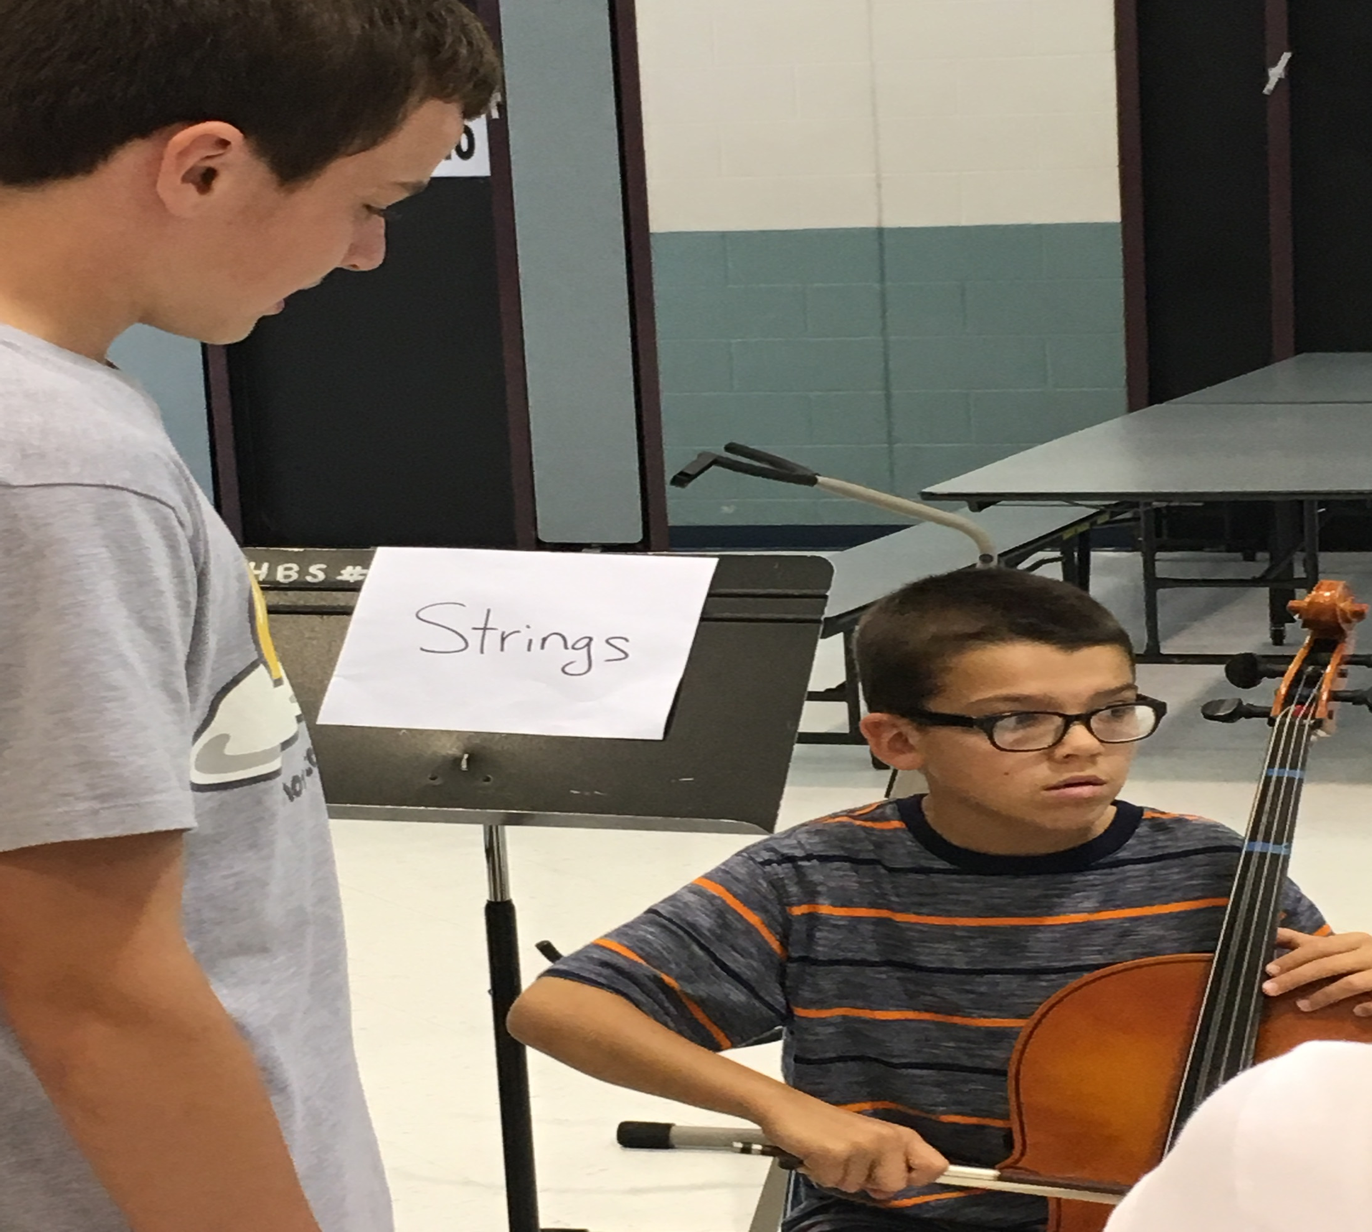

Slide 20
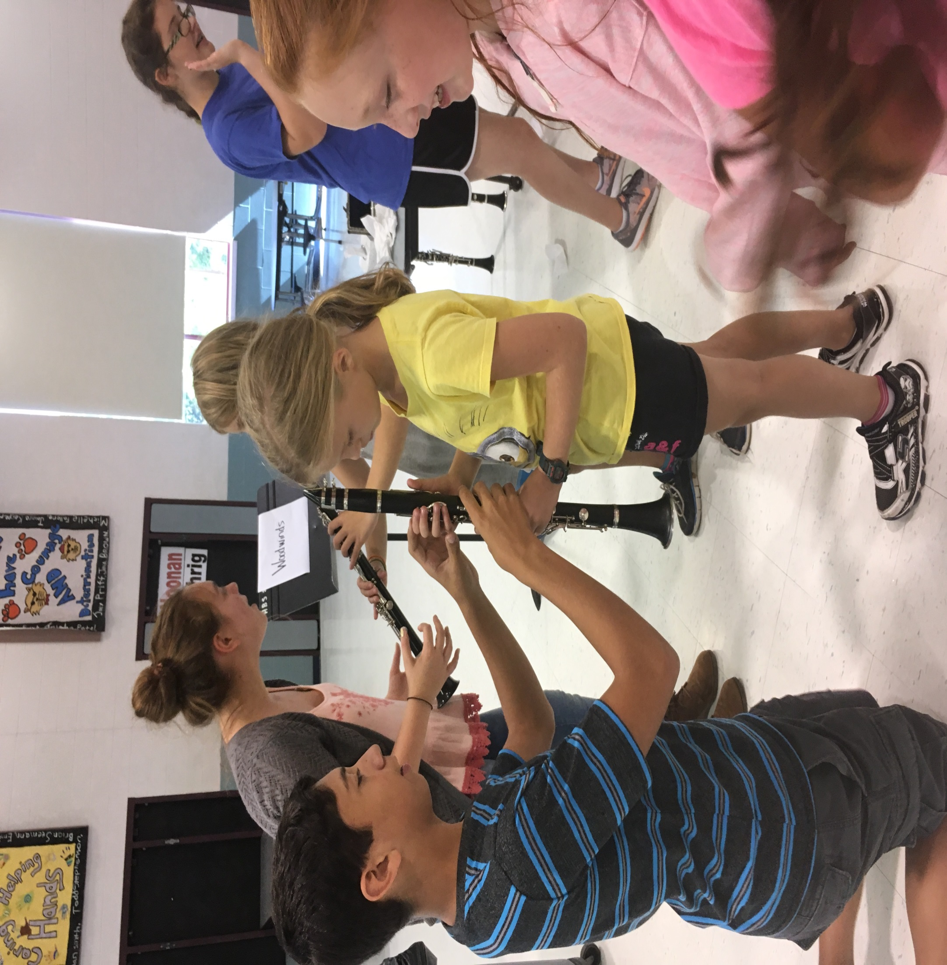

Slide 21
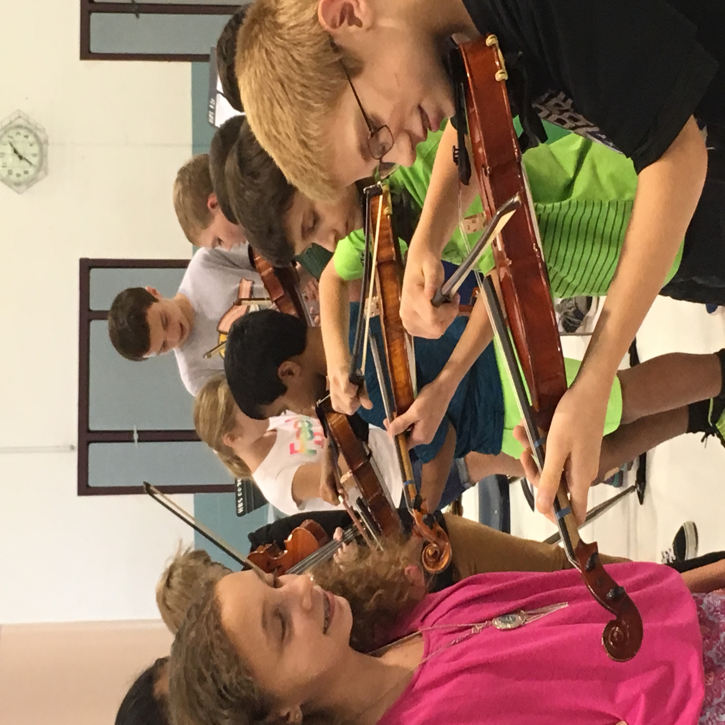

Slide 22
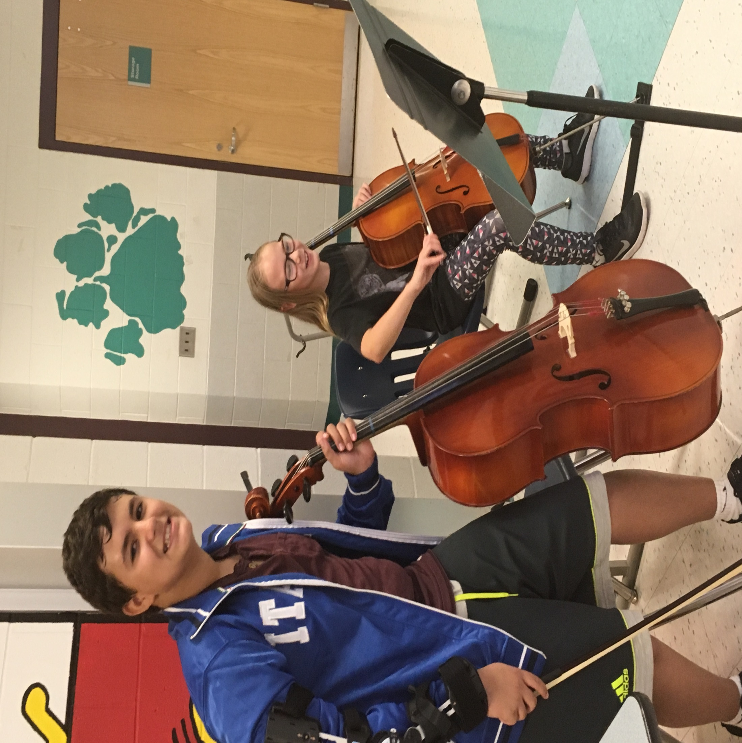

Slide 23
Eliza Rothenberger Mya Corby Allen LaTournous Katie Loew Jimmy Benson Adi Shukla Joey Farrell Michelle Engler Jasneen Meghadri Morgan Owen
Thank you to the RMS student musicians that helped make the
Holland Brook School Instrumental Petting Zoo so successful!
Lauren Mulligan
Vineela Ravilla
Bella Critelli
Aiden Francfort
Brady Quintard
Annabelle Hinks
Jordan Altom
Leah Davitt
Marcello Silva
Lauren Sherman

